Slide 1
Become a Leader
Here is where the workshop begins

Slide 2
01.
THEORY LESSON
02.
FEATURES OF THE TOPIC
03.
OUR TIPS
04.
PRACTICAL EXERCISE
Describe here the topic of the section
Describe here the topic of the section
Describe here the topic of the section
Describe here the topic of the section

Slide 3
Introduction
Mercury is the closest planet to the Sun and the smallest one in the Solar System—it’s only a bit larger than the Moon

Slide 4
01
Theory Lesson
You could enter a subtitle here if you need it

Slide 5
What Is This Topic About?
MERCURY
VENUS
MARS
Mercury is the closest planet to the Sun
Venus is the second planet from the Sun
Despite being red, Mars is actually a cold place

Slide 6
CONCEPT 1
CONCEPT 2
Mercury is the closest planet to the Sun and the smallest one
Venus has a beautiful name and also very high temperatures

Slide 7
Features of the Topic
WRITE ABOUT THE TOPIC
You can write about the features of the topic here
You can write about the features of the topic here
You can write about the features of the topic here

Slide 8
Examples
MERCURY
JUPITER
MARS
NEPTUNE
Mercury is the closest planet to the Sun
Jupiter is the biggest planet of them all
Despite being red, Mars is a cold place
Neptune is the farthest planet from the Sun

Slide 9
Recommendations
MERCURY
JUPITER
SATURN
MARS
NEPTUNE
VENUS
Mercury is the smallest planet
It’s the biggest planet of them all
Saturn is the ringed one and a gas giant
Despite being red, Mars is a cold place
It’s the farthest planet from the Sun
Venus has a nice
name, but it’s hot

Slide 10
Professional Outings
20%
50%
30%
Mercury was named after the Roman messenger god
Venus has a beautiful name, but it’s terribly hot
Despite being red, Mars is actually a cold place

Slide 11
Workshop Contents
 | LESSON 1 | LESSON 2 | LESSON 3 | LESSON 4
MAY | 2nd - 29th | - | - | -
JUNE | - | 1st - 15th | 16th - 25th | -
JULY | - | - | - | 1st - 14th

Slide 12
A Picture Is Worth a Thousand Words

Slide 13
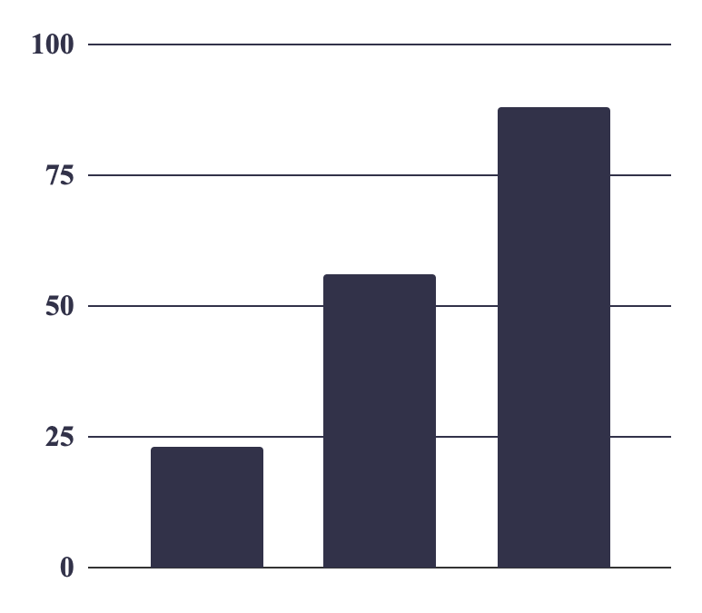
Our Students
To modify this graph, follow the link, change the data and replace it

Slide 14
Our Students
50%
20%
30%

Slide 15
2,455
Are the people who have successfully passed the workshop

Slide 16
Workshop Process
Saturn is the ringed planet
Venus has a nice name, but it’s hot
Week 1
Week 2
Week 3
Week 4
Mercury is the smallest planet
Mars is red and a cold place

Slide 17
Multimedia Content
Workshop Online
You can replace the image on these screens with your own ones

Slide 18
Practical Exercise
?
?
?
Mercury is the closest planet to the Sun and the smallest one in the Solar System
Venus
Mars
Jupiter

Slide 19
Thanks!
Do you have any question? youremail@greatppt.com
+00 000 000 000
www.greatppt.com
Free Template from GreatPPT.com

Slide 20
Alternative Resources

Slide 21
Fonts & colors used
This presentation has been made using the following fonts:
Abril Fatface
(https://fonts.google.com/specimen/Abril+Fatface)
Montserrat
(https://fonts.google.com/specimen/Montserrat)
#efecd2
#323249
#404066
#9e4b51
#55adc9

Slide 22
Use our editable graphic resources...
You can easily resize these resources without losing quality. To change the color, just ungroup the resource and click on the object you want to change. Then, click on the paint bucket and select the color you want. Group the resource again when you’re done. You can also look for more infographics on Greatppt.com.

Slide 25
JANUARY
FEBRUARY
MARCH
APRIL
MAY
JUNE
PHASE 1
Task 1
Task 2
PHASE 2
Task 1
Task 2
JANUARY
FEBRUARY
MARCH
APRIL
PHASE 1
Task 1
Task 2

Slide 28
...and our sets of editable icons
You can resize these icons without losing quality.
You can change the stroke and fill color; just select the icon and click on the paint bucket/pen.
In Google Slides, you can also use Flaticon’s extension, allowing you to customize and add even more icons.

Slide 29
Educational Icons
Medical Icons

Slide 30
Business Icons
Teamwork Icons

Slide 31
Help & Support Icons
Avatar Icons

Slide 32
Creative Process Icons
Performing Arts Icons

Slide 33
Nature Icons

Slide 34
SEO & Marketing Icons

Slide 35
www.greatppt.com
Free Templates and Themes
Create beautiful presentations in minutes

