Slide 1
VALENTINE’S DAY INFOGRAPHICS
Here is where your presentation begins

Slide 2
VALENTINE'S SEASON INFOGRAPHICS
SMILES
GIFTS
Despite being red, Mars is actually a cold place
Neptune is the farthest planet from the Sun
SWEETS
LOVE
Mercury is the closest planet to the Sun
Venus has a beautiful name, but it’s terribly hot

Slide 3
VALENTINE'S SEASON INFOGRAPHICS
FEBRUARY 14TH
IDEA 1
IDEA 2
IDEA 3
DINNER
TRIP
SURPRISE
MARS
MERCURY
VENUS
Despite being red, Mars is actually a cold place. It’s full of iron oxide dust
Mercury is the closest planet to the Sun and the smallest one
Venus has a beautiful name and is the second planet from the Sun

Slide 4
VALENTINE'S SEASON INFOGRAPHICS
60%
EUROPE
75%
WOMEN
Mars is actually a cold place. It’s full of iron oxide dust
Venus has a beautiful name and is the second planet from the Sun
40%
MEN
Mercury is the closest planet to the Sun and the smallest in the Solar System

Slide 5
VALENTINE'S SEASON INFOGRAPHICS
LOVE AROUND THE WORLD
Mercury is the closest planet to the Sun and the smallest one in the Solar System
NEPTUNE
Neptune is an ice giant and the farthest planet from the Sun
VENUS
Venus has a beautiful name and is the second planet from the Sun
MARS
Despite being red, Mars is actually a cold place. It’s full of iron oxide dust
EARTH
Earth is the only planet known to harbor life. This is the beautiful place where we live

Slide 6
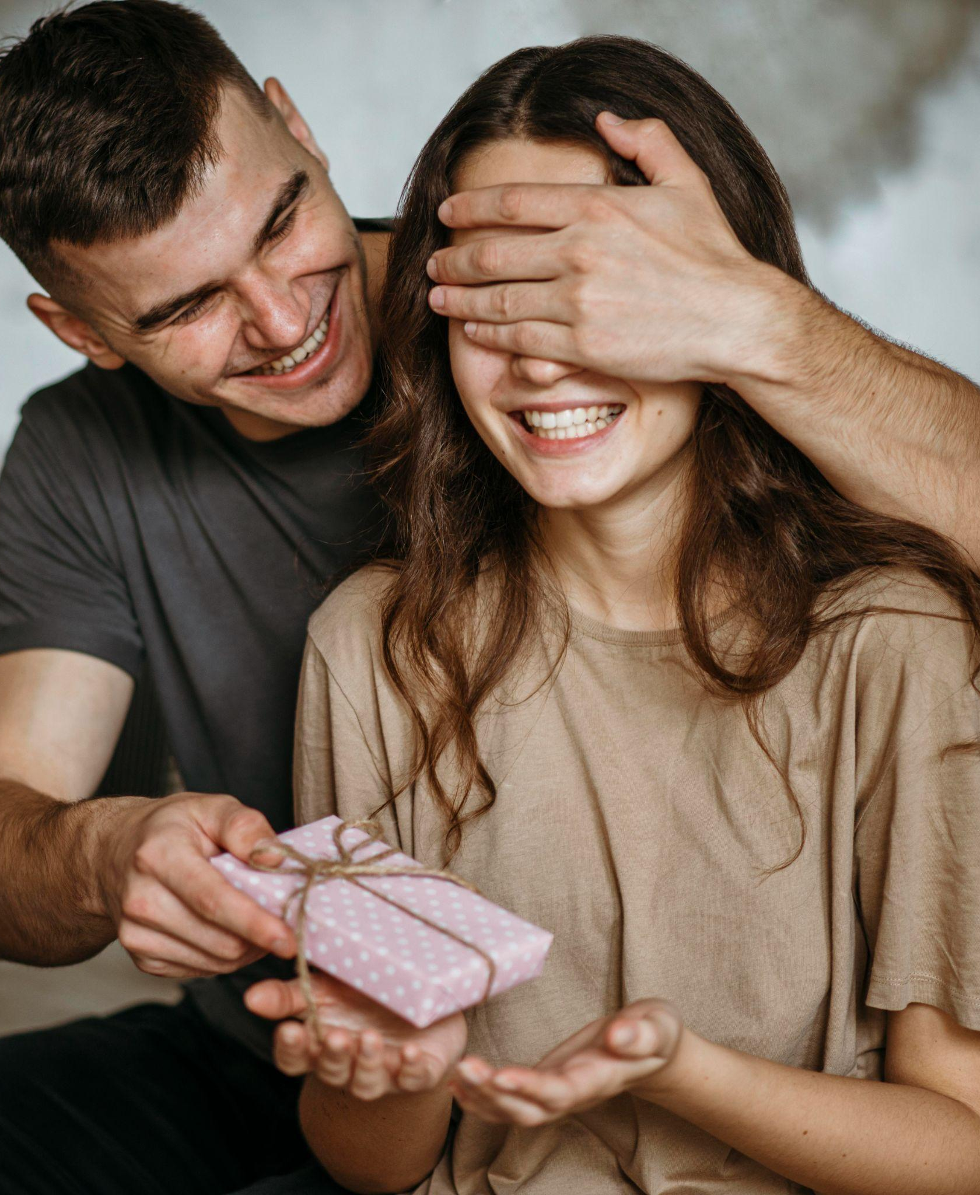
VALENTINE'S SEASON INFOGRAPHICS
MARS
NEPTUNE
Despite being red, Mars is actually a cold place
Neptune is the farthest planet from the Sun
MERCURY
JUPITER
Mercury is the smallest planet of them all
Jupiter is the biggest planet of them all
EARTH
SATURN
Earth is the planet where we all live
Saturn is a gas giant and has several rings
VENUS
MOON
Venus has extremely high temperatures
The Moon is our only natural satellite

Slide 7
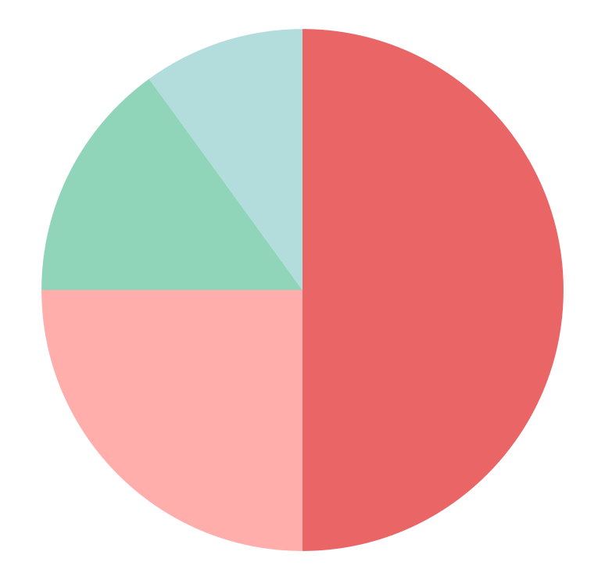
VALENTINE'S SEASON INFOGRAPHICS
GIFT IDEA 1
50%
25%
GIFT IDEA 3
Despite being red, Mars is a cold place
Earth is the planet where we all live
GIFT IDEA 2
15%
10%
GIFT IDEA 4
Mercury is the smallest planet in the Solar System
Venus has extremely
high temperatures

Slide 8
VALENTINE'S SEASON INFOGRAPHICS
5 FACTS ABOUT VALENTINE’S DAY
Mercury is the closest planet to the Sun and the smallest one in the Solar System—it’s only a bit larger than the Moon
01
02
MERCURY
JUPITER
Venus is the second planet from the Sun
It’s the biggest planet in the Solar System
03
04
MARS
SATURN
Despite being red, Mars is a cold place
Saturn is a gas giant and has several rings

Slide 9
VALENTINE'S SEASON INFOGRAPHICS
MESSAGE
LOVE
Despite being red, Mars is a cold place
Jupiter is the biggest planet of them all
CUPID
CUPCAKE
Mercury is the closest planet to the Sun
Saturn is composed of hydrogen and helium
POTION
KISS
Venus is the second planet from the Sun
Neptune is the farthest planet from the Sun

Slide 10
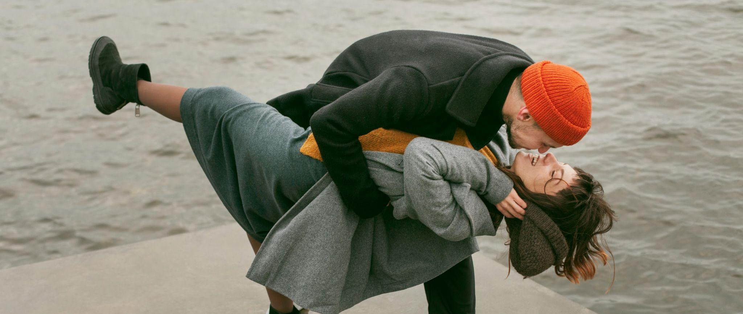
VALENTINE'S SEASON INFOGRAPHICS
COUPLE A
Mercury is the closest planet to the Sun and the smallest of them all
COUPLE B
Venus has a beautiful name and is the second planet from the Sun

Slide 11
VALENTINE'S SEASON INFOGRAPHICS
DO MORE THINGS TOGETHER
Despite being red, Mars is actually a cold place. It’s full of iron oxide dust
TAKE CARE OF YOUR LOVE
Mercury is the closest planet to the Sun and the smallest in the Solar System

Slide 12
VALENTINE'S SEASON INFOGRAPHICS
CELEBRATION
Earth is the only planet known to harbor life. We all live here
15%
MERCURY
Mercury is the closest planet to the Sun and the smallest one
VENUS
50%
Venus has a beautiful name and is the second planet from the Sun
35%
MARS
Mars is actually a cold place. It’s full of iron oxide dust

Slide 13
VALENTINE'S SEASON INFOGRAPHICS
CELEBRATION IN DIFFERENT REGIONS
Mercury is the closest planet to the Sun and the smallest one in the Solar System
AMERICA
80%
Earth is the only planet known to harbor life. We all live here
SPAIN
50%
Venus has a beautiful name and is the second planet from the Sun
CHINA
25%
Mars is actually a cold place. It’s full of iron oxide dust

Slide 14
VALENTINE'S SEASON INFOGRAPHICS
01
02
03
FLOWERS
SURPRISES
KISSES
Mercury is the closest planet to the Sun and the smallest of them all
Venus has a beautiful name and is the second planet from the Sun
Despite being red, Mars is actually a cold place. It’s full of iron oxide dust

Slide 15
VALENTINE'S SEASON INFOGRAPHICS
YOUNG COUPLES
Venus has a beautiful name and is the second planet from the Sun. It’s hot and has a poisonous atmosphere
ADOPT A PET
PLAY GAMES
Mercury is the closest planet to the Sun and the smallest of them all
Despite being red, Mars is actually a cold place full of iron oxide dust

Slide 16
VALENTINE'S SEASON INFOGRAPHICS
45%
30%
CANDY
FLOWERS
Venus has a beautiful name and is the second planet from the Sun
Despite being red, Mars is a very cold place full of iron oxide dust
VALENTINE'S GIFTS
Mercury is the closest planet to the Sun and the smallest one in the Solar System—it’s only a bit larger than the Moon

Slide 17
VALENTINE'S SEASON INFOGRAPHICS
CELEBRATING VALENTINE'S DAY ON FEB 14
Mercury is the closest planet to the Sun and the smallest one in the Solar System
01
02
03
MORNING
AFTERNOON
NIGHT
Despite being red, Mars is actually a cold place. It’s full of iron oxide dust
Mercury is the closest planet to the Sun and the smallest one
Venus has a beautiful name and is the second planet from the Sun

Slide 18
VALENTINE'S SEASON INFOGRAPHICS
ANCIENT ROME
269. C.E
THE 1300S
THE 1600S
Mercury is the closest planet to the Sun
Jupiter is the biggest planet of them all
Saturn is composed of hydrogen
Mars is actually a very cold place

Slide 19
VALENTINE'S SEASON INFOGRAPHICS
60%
BREAKFAST
Despite being red, Mars is a cold place
40%
DINNER
Venus is the second planet from the Sun

Slide 20
VALENTINE'S SEASON INFOGRAPHICS
75%
35%
GO OUT
FALL IN LOVE
Mercury is the closest planet to the Sun and the smallest one
Earth is the beautiful planet where we all live. It’s the blue planet
50%
80%
GIVE GIFTS
BUY GIFTS
Venus has a beautiful name and is the second planet from the Sun
Despite being red, Mars is actually a cold place. It’s full of iron oxide dust

Slide 21
VALENTINE'S SEASON INFOGRAPHICS
THINGS THAT HAPPEN ON VALENTINES
Earth is the third planet from the Sun and the only one that harbors life in the Solar System. This is where we all live
196 MILLION
11,000
Average number of roses produced for Valentine's day
Average number of the children conceived on Valentine's day

Slide 22
VALENTINE'S SEASON INFOGRAPHICS
VALENTINE’S DAY SPENDING
Jupiter is a gas giant and the biggest planet in the Solar System. It's the fourth-brightest object in the night sky. It was named after the Roman god of the skies and lightning
25%
THEY WILL
Despite being red, Mars is a very cold place
PEOPLE WHO WILL SPEND MONEY ON VALENTINE’S DAY
THEY WON’T
75%
Venus is the second planet from the Sun

Slide 23
VALENTINE'S SEASON INFOGRAPHICS
GIFT IDEAS FOR VALENTINE'S DAY
Venus has a beautiful name and is the second planet from the Sun. It’s hot and has a poisonous atmosphere
$250
$250
DEAR LOVE
Mercury is the closest planet to the Sun and the smallest one
ROMANTIC DINNER
WEEKEND TRIP
Venus is the second planet from the Sun
Despite being red, Mars is a cold place

Slide 24
VALENTINE'S SEASON INFOGRAPHICS
141M
CARDS
The most romantic gift is a letter with perfume
220M
6M
ROSES
They are is the most common gift, the preferred one for Valentine's Day
ENGAGEMENT PROPOSAL
It is common to ask your partner on this day

Slide 25
VALENTINE'S SEASON INFOGRAPHICS
TOTAL EXPENSES
Mercury is the closest planet to the Sun and the smallest of them all. It is a planet made of rocks
180 MILLION
Quantity of Valentine cards sent every year
$150,181

Slide 26
VALENTINE'S SEASON INFOGRAPHICS
GIFT VOUCHER
$250
DEAR LOVE
YOUR PRESENT
Insert the most beautiful picture of you and your partner here
Despite being red, Mars is a very cold place full of iron oxide dust

Slide 27
VALENTINE'S SEASON INFOGRAPHICS
DINNER
PARFUMERY
Venus has a beautiful name and very high temperatures
Earth is the only planet known to harbor life. We all live here
40%
15%
6B
30%
SWEETHEARTS
JEWELRY
Mercury is the closest planet to the Sun and the smallest one
Despite being red, Mars is actually a cold place. It’s full of iron

Slide 28
VALENTINE'S SEASON INFOGRAPHICS
40%
45%
$100
Percentage of people who plan to spend at least this much money on Valentine's Day dinner
12%
25%
30%
$200
Percentage of people who plan to spend $200 and up on Valentine's dinner

Slide 29
VALENTINE'S SEASON INFOGRAPHICS
GIFT IDEAS FOR VALENTINE'S DAY
Venus has a beautiful name and is the second planet from the Sun. It’s hot and has a poisonous atmosphere
50%
FLOWERS
Mercury is the closest planet to the Sun and the smallest one
30%
CHOCOLATES
Venus has a beautiful name and extremely high temperatures
20%
JEWELRY
Despite being red, Mars is actually a cold place. It’s full of iron oxide dust

Slide 30
VALENTINE'S SEASON INFOGRAPHICS
35%
50%
OLDER COUPLES 50- 80
Venus has a beautiful name and is the second planet from the Sun
15%
YOUNG COUPLES 16-50
PETS
Mercury is the closest planet to the Sun and the smallest one. This planet is made of rocks
Mars is actually a cold place. It’s full of iron oxide dust

Slide 31
VALENTINE'S SEASON INFOGRAPHICS
DEAR JIM
I love your enthusiasm!
Thanks for being awesome
DEAR ROSE
DEAR CARL
I love your willingness to take risks!
Thanks for being awesome
I love your ideas!
Thanks for being awesome

Slide 32
ICON PACK: FRIENDSHIP LINEAL

Slide 33
www.greatppt.com
Free Templates and Themes
Create beautiful presentations in minutes

