Slide 1
World Atlas Theme Infographics
Here’s where your presentation begins

Slide 2
World atlas theme infographics
JUPITER
01
02
NEPTUNE
Jupiter is a gas giant and the biggest planet
Neptune is the farthest planet from the Sun
MERCURY
03
04
MARS
Mercury is the closest planet to the Sun
Despite being red, Mars is a cold place

Slide 3
World atlas theme infographics
MAPS
Jupiter is a gas giant and the biggest planet
WORLD ATLAS
FLAGS
GEOGRAPHY
Mercury is the closest planet to the Sun
Neptune is the farthest planet from the Sun

Slide 4
World atlas theme infographics
45%
30%
25%
KEY STATISTICS
DATA
VISUALIZATIONS
Venus has a very beautiful name but is actually terribly hot
Jupiter is a huge gas giant named after the Roman god of the skies
Earth is the third planet from the Sun and the one that harbors life

Slide 5
World atlas theme infographics
01 |  | DEMOGRAPHY | Jupiter is a gas giant
02 |  | GEOGRAPHY | Neptune is very far away from us
03 |  | POLITICS | Mercury is the smallest planet
04 |  | AREA | Despite being red, Mars is cold
05 |  | GEOLOGY | Venus has a beautiful name

Slide 6
World atlas theme infographics
MAPS
COUNTRIES
STATES
REGIONS
Jupiter is the biggest planet of them all
Mercury is the closest planet to the Sun
Saturn is a gas giant and has several rings
Despite being red, Mars is a cold place
Pluto is considered a dwarf planet
Earth is the third planet from the Sun

Slide 7
World atlas theme infographics
 | HONDURAS | CHINA | CANADA
POPULATION | 9,904,607 | 1,439,323,776 | 9,093,510
AREA | 111,890 Km² | 9,388,211 Km² | 37,742,154 Km²
NOTES | Mercury is the smallest planet | Despite being red, Mars is cold | Venus has a nice name but is hot

Slide 8
World atlas theme infographics
1
NATIONAL DATA
Venus has a beautiful name but is hot
WORLD ATLAS
2
RANKINGS
Earth is the third planet from the Sun
3
REGIONAL MAPS
Jupiter is the biggest planet of them all

Slide 9
World atlas theme infographics
01
02
03
MOUNTAINS
RIVERS
GULFS
Mercury is the closest planet to the Sun
Pluto is now considered a dwarf planet
Neptune is the farthest planet from the Sun
50%
25%
75%

Slide 10
World atlas theme infographics
WORLD ATLAS
MAPS
CARTOGRAPHY
CAPITALS
OCEANS
Jupiter is a gas giant and the biggest planet
Mercury is the closest planet to the Sun
Venus has a nice name but is a very hot place
Pluto is now considered a dwarf planet

Slide 11
World atlas theme infographics
FAUNA
CLIMATE
Jupiter is a gas giant and the biggest planet
Venus has a nice name but is a very hot place
FLORA
WATERBODIES
Mercury is the closest planet to the Sun
Pluto is considered a dwarf planet

Slide 12
World atlas theme infographics
01 | MAPS | Jupiter is a gas giant and the biggest planet of them all
02 | DATA | Mercury is the closest planet to the Sun and the smallest one
03 | MOUNTAINS | Venus has a beautiful name but is actually really hot
04 | OCEANS | Earth is the third planet from the Sun and harbours life

Slide 13
World atlas theme infographics
WORLD ATLAS
PHYSICAL
POLITICAL
Jupiter is a gas giant
Mercury is the smallest planet
Venus has a beautiful name
Earth is where we all live
Despite being red, It’s cold
Pluto is a dwarf planet
Ceres is in an asteroid belt
Neptune is far away from us
The Moon is our satellite
Mercury is the smallest planet

Slide 14
World atlas theme infographics
03
02
NATIVE SPECIES
01
Earth is the third planet from the Sun and the one that harbors life
AREA
Jupiter is a huge gas giant named after the Roman god of the skies
POPULATION
Venus has a very beautiful name but is actually terribly hot

Slide 15
World atlas theme infographics
JUPITER
MERCURY
VENUS
Jupiter is a gas giant and the biggest planet
Mercury is the closest planet to the Sun
Venus has a nice name but is a very hot place

Slide 16
World atlas theme infographics
60%
40%
VS
EUROPE
AMERICA
Jupiter is the biggest planet of them all
Mercury is the closest planet to the Sun
Pluto is considered a dwarf planet
Earth is the third planet from the Sun

Slide 17
World atlas theme infographics
AFRICA | AMERICA | OCEANIA
Saturn is a gas giant and has several rings | Mercury is the smallest planet of them all | Jupiter is the biggest planet of them all

Slide 18
World atlas theme infographics
MOUNTAINS
50%
Mercury is the smallest planet
RIVERS
25%
Venus has a beautiful name
CITIES
75%
Mars is actually a very cold place

Slide 19
World atlas theme infographics
 | MAPS | GEOPOLITICS | DEMOGRAPHY
Mercury is the closest planet to the Sun
Venus is the second planet from the Sun
Despite being red, Mars is a cold place

Slide 20
World atlas theme infographics
ECONOMY
Jupiter is a huge gas giant named after the Roman god of the skies
POPULATION
TERRITORY
Venus has a very beautiful name but is actually terribly hot
Earth is the third planet from the Sun and the one that harbors life

Slide 21
World atlas theme infographics
20%
10%
30%
40%
MERCURY
MARS
JUPITER
SATURN
Mercury is the smallest planet
Despite being red, Mars is cold
Jupiter is the biggest planet of them all
Saturn is the ringed gas giant

Slide 22
World atlas theme infographics
WORLD ATLAS
MAPS
CAPITALS
TEMPERATURES
Jupiter is a gas giant and the biggest planet
Mercury is the closest planet to the Sun
Neptune is the farthest planet from the Sun
Despite being red, Mars is a cold place
Pluto is considered a dwarf planet
Earth is the third planet from the Sun

Slide 23
World atlas theme infographics
STEP 1
STEP 3
STEP 5
Mercury is the closest planet to the Sun
Venus has a
beautiful name
Neptune is the fourth-largest planet
STEP 2
STEP 4
Jupiter is the biggest planet of them all
Saturn is the ringed planet and a gas giant

Slide 24
World atlas theme infographics
60%
EARTH
Earth is the third planet from the Sun
10%
VENUS
Venus has a very beautiful name but is hot
30%
JUPITER
Jupiter is a huge gas giant named after a god

Slide 25
World atlas theme infographics
POLITICAL MAPS
 | Regions
 | Capitals
 | Frontiers
 | Demography
PHYSICAL MAPS
 | Rivers
 | Mountains
 | Oceans
 | Seas

Slide 26
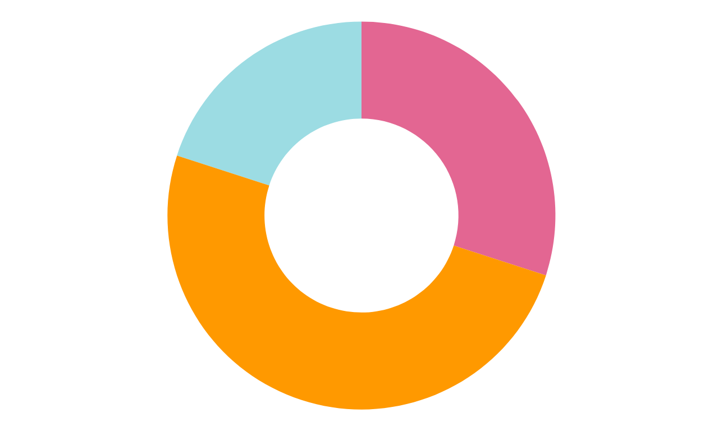
World atlas theme infographics
30%
EARTH
Earth is the third planet from the Sun
20%
JUPITER
Jupiter is a huge gas giant named after a god
50%
VENUS
Venus has a very beautiful name but is hot
Follow the link in the graph to modify its data and then paste the new one here. For more info, click here

Slide 27
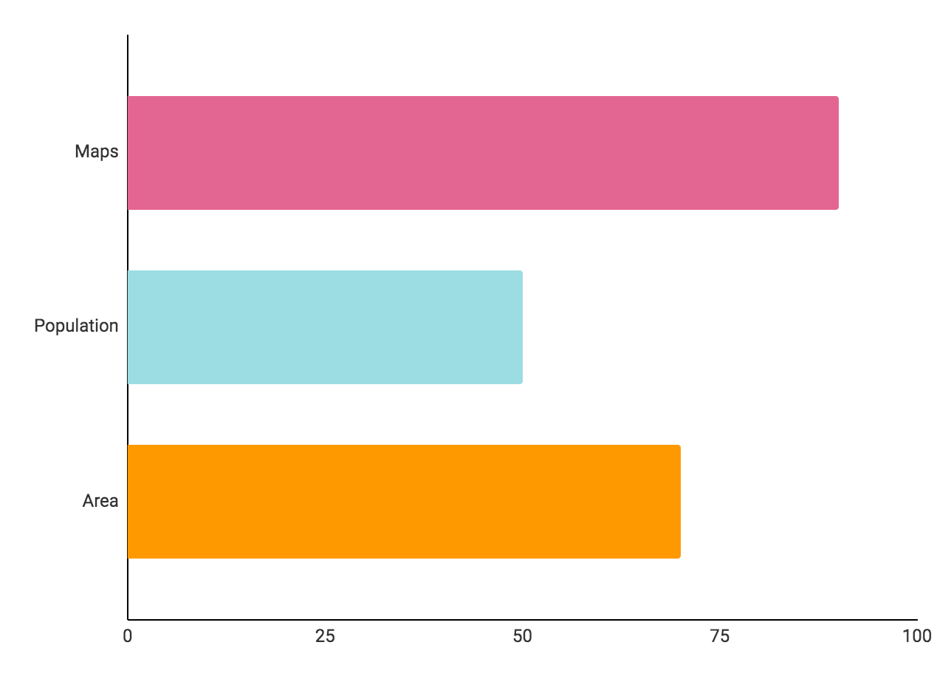
World atlas theme infographics
MAPS
Earth is the third planet from the Sun
90%
POPULATION
50%
Venus has a very beautiful name but is hot
AREA
70%
Jupiter is a huge gas giant named after a god
Follow the link in the graph to modify its data and then paste the new one here. For more info, click here

Slide 28
World atlas theme infographics
CARTOGRAPHY
CAPITALS
Mercury is the closest planet to the Sun
Venus has a nice name but is a very hot place
MAPS
OCEANS
Jupiter is a gas giant and the biggest planet
Pluto is now considered a dwarf planet

Slide 29
World atlas theme infographics
POPULATION
Venus has a very beautiful name but is actually terribly hot
80%
NATIVE SPECIES
Earth is the third planet from the Sun and the one that harbors life
AREA
Jupiter is a huge gas giant named after the Roman god of the skies
50%
30%

Slide 30
World atlas theme infographics
WORLD ATLAS
MOUNTAINS
OCEANS
Jupiter is a gas giant
Mercury is the smallest planet
Venus has a beautiful name
Pluto is a dwarf planet
Ceres is in the main asteroid belt
Neptune is very far away from us

Slide 31
World atlas theme infographics
JUPITER
MERCURY
Jupiter is a gas giant and the biggest one
Mercury is the closest planet to the Sun

Slide 32
Infographics
You can add and edit some infographics to your presentation to present your data in a visual way.
Choose your favourite infographic and insert it in your presentation using Ctrl C + Ctrl V or Cmd C + Cmd V in Mac.
Select one of the parts and ungroup it by right-clicking and choosing “Ungroup”.
Change the color by clicking on the paint bucket.
Then resize the element by clicking and dragging one of the square-shaped points of its bounding box (the cursor should look like a double-headed arrow). Remember to hold Shift while dragging to keep the proportions.
Group the elements again by selecting them, right-clicking and choosing “Group”.
Repeat the steps above with the other parts and when you’re done editing, copy the end result and paste it into your presentation.
Remember to choose the “Keep source formatting” option so that it keeps the design. For more info, please visit our blog.

Slide 33
www.greatppt.com
Free Templates and Themes
Create beautiful presentations in minutes

