Slide 1
United States Geography Infographics
Here is where your template begins

Slide 2
United States geography infographics
Census regions and divisions
New England
Pacific States
Mars has iron oxide
Saturn is a gas giant
Mid-Atlantic
Mountain
Jupiter is a gas giant
Mercury is small
East South
West North
Saturn has rings
Venus is hot
East North
West South
Neptune is blue
Earth harbors life
South Atlantic
Pluto is a dwarf planet

Slide 3
United States geography infographics
Land (L) and water (W) borders of the United States
1
Canada (L)
Mercury is the closest planet to the Sun
Bahamas (W)
4
1
Jupiter is the biggest planet of them all
2
Mexico (L)
Earth is the third planet from the Sun
Cuba (W)
5
3
Saturn is a gas giant and has several rings
3
Russia (W)
4
Venus is the second planet from the Sun
2
5

Slide 4
United States geography infographics
Tornadoes and hurricanes
45%
Mercury
Mercury is the closest planet to the Sun
30%
Venus
Venus is the second planet from the Sun
25%
Jupiter
Jupiter is the biggest planet in the Solar System

Slide 5
United States geography infographics
Lake Superior
Mercury is the smallest planet
Lake Huron
Venus has high temperatures
Lake Ontario
Great lakes basin of the United States of America
Saturn is the planet with rings
Lake Erie
Earth is the planet with life
Lake Michigan
Jupiter is the biggest planet

Slide 6
United States geography infographics
Main cities by population
Saturn is a gas giant and has several rings
New York City
9M
Jupiter is the biggest planet of them all
Los Angeles
4M
Neptune is the farthest planet from the Sun
Chicago
3M
Earth is the third planet from the Sun
Brooklyn
3M

Slide 7
United States geography infographics
Midwest
West
Mercury is the closest planet to the Sun and the smallest one
Northeast
Earth is the third planet from the Sun and where we all live
Despite being red, Mars is actually a very cold place
Southwest
Southeast
Venus is the second planet from the Sun. It’s very hot
Jupiter is the biggest planet of the entire Solar System

Slide 8
United States geography infographics
Some important states
New York
Saturn is a gas giant with several rings
Pennsylvania
Jupiter is the fifth planet from the Sun
California
Neptune is the farthest planet from the Sun
Texas
Earth is the third planet from the Sun

Slide 9
United States geography infographics
Annual average max temperature (F)
30 °F - 40 °F
40 °F - 50 °F
Mercury is the closest planet to the Sun
Saturn is a gas giant and has several rings
50 °F - 60 °F
60 °F - 70 °F
Venus is the second planet from the Sun
Mars is actually a very cold place
70 °F - 80 °F
80 °F - 90 °F
Jupiter is the biggest planet of them all
Neptune is the farthest planet from the Sun

Slide 10
United States geography infographics
The most important cities
3
1
New York
Los Angeles
Neptune is the farthest planet from the Sun
Earth is the third planet from the Sun
4
2
Chicago
Washington
The Sun is the star that we all orbit around
Saturn is a gas giant with several rings

Slide 11
United States geography infographics
Data of some states
State | Capital | Largest city | Area | Population
Arizona | Phoenix | Phoenix | 295,234 km² | 7,279,000
Colorado | Denver | Denver | 269,837 km² | 5,759,000
Georgia | Atlanta | Atlanta | 153,909 km² | 10,620,000
Illinois | Springfield | Chicago | 141.1 km² | 12,670,000
Maine | Augusta | Portland | 91,646 km² | 1,344,000
Oregon | Salem | Portland | 254,806 km² | 4,218,000

Slide 12
United States geography infographics
US time zones
1
2
4
3
Pacific Time
Mountain Time
Central Time
Eastern Time
Neptune is the farthest planet from the Sun
Earth is the third planet from the Sun
The Sun is the star we all orbit around
Saturn is a gas giant with several rings

Slide 13
United States geography infographics
Major rivers
6
1
Columbia River
Missouri River
Mercury is the closest planet to the Sun
Neptune is the farthest planet to the Sun
Colorado River
Hudson River
Despite being red, Mars is a cold place
5
2
Venus is the second planet from the Sun
Rio Grande
Mississippi River
Jupiter is a gas giant and the biggest planet
Saturn is the ringed one. It’s also a gas giant
4
3

Slide 14
United States geography infographics
Mountain range
Rocky Mountain
45%
Mercury is the closest planet to the Sun
20%
Venus is the second planet from the Sun
35%
Sierra Nevada
Appalachian
Jupiter is the biggest planet in the Solar System

Slide 15
United States geography infographics
US population by race
White and European Americans
Hispanic and Latino Americans
Black and African Americans
Asian Americans and others
American Indians & Alaska Natives
Jupiter is the biggest planet of them all
Neptune is the farthest planet from the Sun
Mercury is the smallest planet of them all
Saturn is a gas giant and has several beautiful rings
Venus has a beautiful name and high temperatures
60%
18%
14%
6%
2%

Slide 16
United States geography infographics
Climate zones
It’s the closest planet to the Sun and the smallest
Mercury
80 °F
Mars
Mars is a cold place and is full of iron oxide dust
70 °F
It is the farthest planet from the Sun
Neptune
60 °F
Saturn
It’s composed mostly of hydrogen and helium
50 °F
40 °F
It’s a gas giant and the biggest planet
Jupiter
Venus
Venus has extremely high temperatures
30 °F

Slide 17
United States geography infographics
Major deserts
30%
Great Basin Desert
Mojave Desert
Neptune is very far from the Sun
Jupiter is the biggest planet
20%
Sonora Desert
Chihuahuan Desert
35%
Mercury is the smallest planet
Earth is the third planet from the Sun
15%

Slide 18
United States geography infographics
Political parties
55 %
45 %
Venus
Mercury
Venus has a beautiful name and is the second planet from the Sun. It’s terribly hot
Mercury is the closest planet to the Sun and the smallest one in the Solar System

Slide 19
United States geography infographics
Religion in the US
Atheist
5%
Agnostic
6%
Jupiter is the biggest planet of them all
Mercury is the closest planet to the Sun
Unaffiliated
18%
Others
8%
Neptune is the farthest planet from the Sun
Venus is the second planet from the Sun
Catholic
21%
Protestant
42%
Earth is the third planet from the Sun
Jupiter is the biggest planet of them all
Follow the link in the graph to modify its data and then paste the new one here. For more info, click here

Slide 20
United States geography infographics
Natural disasters by states
Disasters | California | Texas | Oklahoma | Florida | New York
Tornadoes
Hurricanes
Floods
Wildfires
Earthquakes

Slide 21
United States geography infographics
Generalities of US
Washington D.C.
Jupiter is a gas giant and the biggest planet in the Solar System. It's the fourth-brightest object in the night sky
Area
Mercury is the smallest one in the Solar System. This planet's name has nothing to do with the liquid metal

Slide 22
United States geography infographics
Northeast states
New Hampshire
Maine
Mercury is the smallest planet
Earth is the planet with life
Vermont
Massachusetts
Mars is actually a cold place
Neptune is far from the Sun
New York
Rhode Island
Jupiter is the biggest planet
Pluto is a dwarf planet
Pennsylvania
Connecticut
Venus has high temperatures
The Sun is the star we orbit
Maryland
New Jersey
Saturn is the planet with rings
Ceres is an asteroid

Slide 23
United States geography infographics
Most devastating natural disasters in each state
Montana | Kansas | California | Michigan | Florida
Jupiter is the biggest planet of them all | Saturn is a gas giant and has several rings | Neptune is very far from the Sun | Mercury is the smallest planet | Venus is the second planet from the Sun

Slide 24
United States geography infographics
Some protected areas of US.
Yellowstone Caldera
Jupiter is a gas giant and the biggest planet in the Solar System. It's the fourth-brightest object in the night sky
Navajo National Monument
Cape Cod National Seashore
Jupiter is a gas giant and the biggest planet in the Solar System. It's the fourth-brightest object in the night sky
Neptune is the farthest planet from the Sun. It's also the fourth-largest object by diameter in the Solar System

Slide 25
United States geography infographics
Southwest states
1
3
2
Arizona
Oklahoma
Venus has a beautiful name and is the second planet from the Sun
4
Despite being red, Mars is actually a very cold place full of iron oxide
New Mexico
Texas
Mercury is the closest planet to the Sun and the smallest of them all
Jupiter is a gas giant and the biggest planet in the entire Solar System

Slide 26
United States geography infographics
Some important national parks
 | Name | Description
 | Acadia | Mars is a cold place
 | Crater Lake | Saturn has several rings
 | Congare | Venus is a hot planet
 | Death Valley | Mercury is a small planet
 | Great Sand Dunes | Neptune is a blue planet

Slide 27
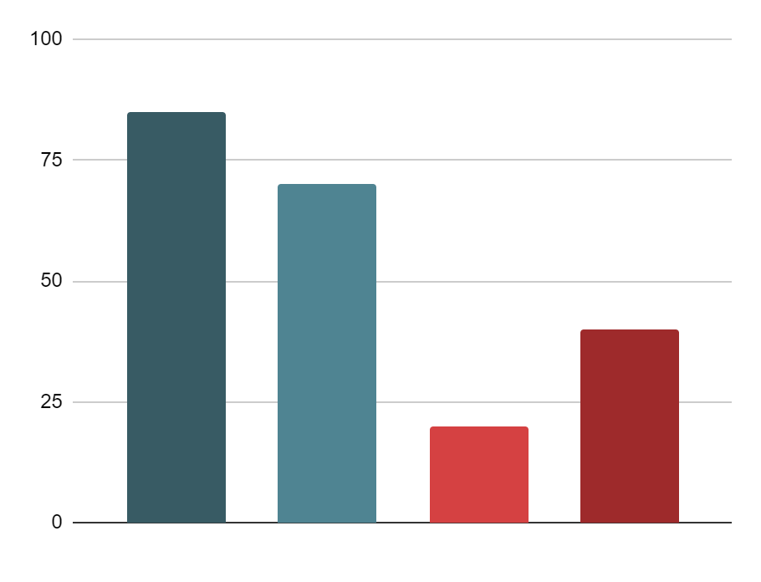
United States geography infographics
Ecological regions in the US
85%
20%
Venus
Mars
Venus is the second planet from the Sun and it is terribly hot
Despite being red, planet Mars is actually a very cold place
70%
40%
Jupiter
Neptune
Jupiter is the biggest planet in the Solar System and a gas giant
Neptune is the farthest planet from the Sun. It’s an ice giant
Follow the link in the graph to modify its data and then paste the new one here. For more info, click here

Slide 28
United States geography infographics
Important landmarks
Space Needle
Liberty Statue
Neptune is the farthest planet from the Sun
Saturn is a gas giant. This is the only planet with rings
Golden Gate
Gateway Arch
Venus has a beautiful name and extremely high temperatures
Jupiter is the biggest planet of them all. It’s a gas giant
Hollywood
The Alamo
US. Capitol
Despite being red, Mars is actually a very cold place
Earth is the third planet from the Sun and where we all live
The Sun is the star that we all orbit. It’s incredibly hot

Slide 29
United States geography infographics
Some southeast states
Mississippi
Alabama
Saturn is a gas giant and has several rings
Neptune is the farthest planet from the Sun
Luisiana
Florida
Venus is the second planet from the Sun
Earth is the only planet known to harbor life

Slide 30
United States geography infographics
Population statistics
Mercury
Mercury is the closest planet to the Sun
80%
Venus
Venus is the second planet from the Sun
60%
Earth
Earth is the third planet from the Sun
40%
Mars
Despite being red, Mars is a very cold place
20%

Slide 31
United States geography infographics
Compare key data of the United States and Canada
United States | Data | Canada
About half the size of Russia | Area | Slightly larger than the US
32.35 people/mA² | Population | 3.55 people/mA²
Tropical in Hawaii and Florida, arctic in Alaska, semiarid in Mississippi | Climate | Varies from temperate in south to subarctic and arctic in north
Coal, copper, lead, molybdenum, phosphates, rare earth elements | Natural resources | Iron ore, nickel, zinc, copper, gold, lead, rare earth elements
Mount McKinley (Denali) 6,194 m | Highest point | Mount Logan 5,959 m

Slide 32
Infographics
You can add and edit some infographics to your presentation to present your data in a visual way.
Choose your favourite infographic and insert it in your presentation using Ctrl C + Ctrl V or Cmd C + Cmd V in Mac.
Select one of the parts and ungroup it by right-clicking and choosing “Ungroup”.
Change the color by clicking on the paint bucket.
Then resize the element by clicking and dragging one of the square-shaped points of its bounding box (the cursor should look like a double-headed arrow). Remember to hold Shift while dragging to keep the proportions.
Group the elements again by selecting them, right-clicking and choosing “Group”.
Repeat the steps above with the other parts and when you’re done editing, copy the end result and paste it into your presentation.
Remember to choose the “Keep source formatting” option so that it keeps the design. For more info, please visit GreatPPT.com.

Slide 33
www.greatppt.com
Free Templates and Themes
Create beautiful presentations in minutes

