Slide 1
Math
Lesson
Here is where your presentation begins

Slide 2
Table of Contents
01
03
Here you could describe the topic of the section
Here you could describe the topic of the section
02
04
Here you could describe the topic of the section
Here you could describe the topic of the section
Overview
Assignment
Features
About the Topic

Slide 3
A Picture is Worth a Thousand Words

Slide 4
01
Overview
You could enter a subtitle here if you need it

Slide 5
Introduction
Venus has a beautiful name and is the second planet from the Sun. It’s terribly hot. It’s the second-brightest natural object in the night sky after the Moon

Slide 6
— SOMEONE FAMOUS
“This is a quote. Words full of wisdom that someone important said and can make the reader get inspired.”

Slide 7
What Is This Topic About?
If you want to talk about Mercury, you could say that it’s the closest planet to the Sun and the smallest one in the Solar System

Slide 8
Definition of Concepts
Mars
Venus
Mercury
Despite being red, Mars is a cold place
Venus is the second planet from the Sun
Is the smallest one in the Solar System

Slide 9
Awesome
Words

Slide 10
Features of the Topic
Mercury
Venus
Mercury is the closest planet to the Sun
Venus is the second planet from the Sun
Jupiter
Mars
It’s a gas giant and the biggest planet
Despite being red, Mars is a cold place, not hot

Slide 11
9,200,000 km2
15 mm
67,700 people
is the area covered by the Sahara
is the average rainfall per year in the Atacama Desert
live in the Kharga Oasis

Slide 12
Practical Uses of This Subject
Venus
Mars
Mercury
Venus is the second planet from the Sun
Despite being red, Mars is a cold place
Mercury is the closest planet to the Sun
Saturn
Jupiter
Neptune
It’s the ringed one and a gas giant
It’s a gas giant and the biggest planet
Is the farthest planet from the Sun

Slide 13
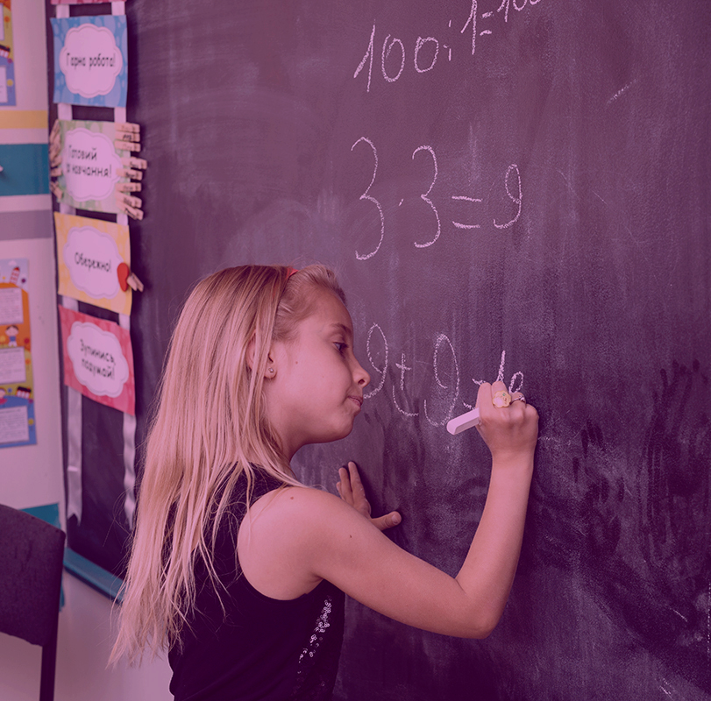
A Picture Always Reinforces the Concept
Images reveal large amounts of data, so remember: use an image instead of a long texts

Slide 14
Multimedia
Despite being red, Mars is a cold place, not hot. It’s full of iron oxide dust, which gives the planet its reddish cast
Insert your multimedia content here

Slide 15
Did You Know This?
Venus
Venus is the second planet from the Sun
Saturn
It’s the ringed one and a gas giant
Jupiter
It’s a gas giant and the biggest planet

Slide 16
1,000.000
Big numbers catch your audience’s attention

Slide 17
Problem VS. Solution
Problem
Solution
Venus has a beautiful name and is the second planet from the Sun
Despite being red, Mars is a cold place. It’s full of iron oxide dust

Slide 18
Process Timeline
Venus is terribly hot
Earth harbors life
Day 5
Day 1
Neptune is far away
Day 3
Day 4
Day 6
Saturn has rings
Day 2
The Sun is a star
Jupiter is a gas giant

Slide 19
Overview Diagram
Jupiter
Mercury
Saturn
Jupiter is a gas giant
Saturn has rings
The Sun is a star

Slide 20
This Is a Graph
Venus
Mercury
Venus is the second planet from the Sun
25 %
20 %
Mercury is the closest planet
Mars
Jupiter
25 %
30 %
Despite being red, Mars is a cold place
It’s a gas giant and the biggest planet
To modify this graph, click on it, follow the link, change the data and paste the new graph here

Slide 21
You Could Use a Map
10,000
Despite being red, Mars is a cold place
25,000
Venus is the second planet from the Sun
Mars
Venus

Slide 22
Exercise 1
Venus | 4+1= | 3-2=
Mars | 6+8= | 5-3=
Jupiter | 10+5= | 10-4=
Saturn | 14+3= | 13-5=

Slide 23
Exercise 2
1.
3.
2.
You Could Write the Name of These Figures
____________________________
____________________________
____________________________

Slide 24
Assignments
Venus
You could write you assignment here
You could write you assignment here
You could write you assignment here
You could write you assignment here
You could write you assignment here

Slide 25
Thanks!
Do you have any questions?
great_ppt@outlook.com
+1(540)328-0772
www.greatppt.com
Free PPT Template from GreatPPT.com

Slide 26
Alternative Resources

Slide 27
Fonts & colors used
This presentation has been made using the following fonts:
Fredoka One
(https://fonts.google.com/specimen/Fredoka+One)
Comfortaa
(https://fonts.google.com/specimen/Comfortaa)
#3c1a32ff
#582f4eff
#ffc715ff
#f9a320ff
#ee4524ff
#88d4cdff
#b872aeff

Slide 28
Use our editable graphic resources...
You can easily resize these resources without losing quality. To change the color, just ungroup the resource and click on the object you want to change. Then, click on the paint bucket and select the color you want. Group the resource again when you’re done. You can also look for more infographics on Slidesgo.

Slide 31
JANUARY
FEBRUARY
MARCH
APRIL
MAY
JUNE
PHASE 1
Task 1
Task 2
PHASE 2
Task 1
Task 2
JANUARY
FEBRUARY
MARCH
APRIL
PHASE 1
Task 1
Task 2

Slide 34
...and our sets of editable icons
You can resize these icons without losing quality.
You can change the stroke and fill color; just select the icon and click on the paint bucket/pen.
In Google Slides, you can also use Flaticon’s extension, allowing you to customize and add even more icons.

Slide 35
Educational Icons
Medical Icons

Slide 36
Business Icons
Teamwork Icons

Slide 37
Help & Support Icons
Avatar Icons

Slide 38
Creative process Icons
Performing Arts Icons

Slide 39
Nature Icons

Slide 40
SEO & Marketing Icons

Slide 41
www.greatppt.com
Free Templates and Themes
Create beautiful presentations in minutes

