Slide 1
Christmas Presents Infographics
Here is where this template begins

Slide 2
Christmas Presents Infographics
Wrapping process
01
02
03
04
Prepare materials
Place the present
Wrap around it
Final touch
Jupiter is the biggest planet of them all
Mercury is the closest planet to the Sun
Saturn is composed of hydrogen and helium
Mars is actually a very cold place

Slide 3
Christmas Presents Infographics
Stop 1
Stop 3
Saturn is composed of hydrogen and helium
Venus is the second planet from the Sun
Stop 2
Stop 4
Despite being red, Mars is a cold place
Mercury is the closest planet to the Sun

Slide 4
Christmas Presents Infographics
venus
mercury
Venus is the second planet from the Sun
Mercury is the closest planet to the Sun
jupiter
mars
Jupiter is the biggest planet of them all
Mars is actually a very cold place

Slide 5
Christmas Presents Infographics
Decorating
Indoors
Festive movies
Christmas activities
Tree hunting
Outdoors
Festive party

Slide 6
Christmas Presents Infographics
The path santa follows
Jupiter is the biggest planet in the Solar System
01
06
Venus has a beautiful name, but also high temperatures
Saturn is composed mostly of hydrogen and helium
02
05
Mercury is the smallest planet in the Solar System
Despite being red, Mars is actually a cold place
03
04
Neptune is the farthest planet from the Sun

Slide 7
Christmas Presents Infographics
To buy | where | Check list
Saturn | Saturn is composed of hydrogen and helium
Jupiter | Jupiter is the biggest planet of them all | -
Mars | Mars is actually a very cold place | -
Venus | Venus is the second planet from the Sun
Neptune | Neptune is the farthest planet from the Sun | -

Slide 8
Christmas Presents Infographics
People | Presents
Mum | Saturn, Neptune, Mars
Dad | Jupiter
Sister | Neptune, Saturn
Brother | Mercury, Venus
Grandparents | Saturn, Mercury, Venus
People | Presents
Anne | Saturn, Neptune, Mars
John | Jupiter
Mary | Neptune, Saturn
Timmy | Mercury, Venus
George | Saturn, Mercury, Venus

Slide 9
Christmas Presents Infographics
Monday | Tuesday | Wednesday | Thursday | Friday | Saturday | Sunday
1 | 2 | 3 | 4 | 5 | 6 | 7
8 | 9 | 10 | 11 | 12 | 13 | 14
15 | 16 | 17 | 18 | 19 | 20 | 21
22 | 23 | 24 | 25 | 26 | 27 | 28
29 | 30 | 31 | 1 | 2 | 3 | 4
Mercury is the closest planet to the Sun
Venus has a beautiful name

Slide 10
Christmas Presents Infographics
Sally wants:
John wants:
Gery wants:
Jen wants:
Video Games
Book
T-shirt
Straightener
Anne wants:
Jo wants:
Tim wants:
Tom wants:
Doll house
Basketball
Bicycle
New clothes

Slide 11
Christmas Presents Infographics
Recipe 1
Recipe 2
Recipe 3
Jupiter is the biggest planet of them all
Mercury is the smallest planet of them all
Saturn is composed of hydrogen and helium

Slide 12
Christmas Presents Infographics
weeks before christmas
Celebration week
01.
Jupiter is the biggest planet in the Solar System
01.
Venus has a beautiful name, but also high temperatures
02.
Saturn is the ringed planet and a gas giant
02.
Neptune is the farthest planet from the Sun
03.
Despite being red, Mars is actually a cold place
03.
Mercury is the smallest planet in the Solar System

Slide 13
Christmas Presents Infographics
from: laura carrobles
to: father christmas
Mercury is the closest planet to the Sun and the smallest one in the Solar System—it’s only a bit larger than the Moon. The planet’s name has nothing to do with the liquid metal
Write the present you want from Santa
Write the present you want from Santa
Write the present you want from Santa
Write the present you want from Santa
Write the present you want from Santa
Write the present you want from Santa
Write the present you want from Santa
Write the present you want from Santa

Slide 14
Christmas Presents Infographics
Despite being red, Mars is actually a cold place
Mercury is the smallest planet in the Solar System
Jupiter is a gas giant and the biggest planet in the Solar System
The Sun is the star at the center of the Solar System
Pluto is now considered a dwarf planet, not a planet
Neptune is the farthest planet from the Sun
Saturn is a gas giant and has several rings
Ceres is located in the main asteroid belt

Slide 15
Christmas Presents Infographics
45%
elves
35%
20%
Venus is the second planet from the Sun
Santa claus
Mother christmas
Despite being red, Mars is actually a cold place
Neptune is the farthest planet from the Sun

Slide 16
Christmas Presents Infographics
Video games
Sport equipment
toys
Neptune is the fourth-largest planet in the Solar System
Jupiter is the fourth-brightest planet in the night sky
Venus has a beautiful name and is the second planet from the Sun
TECHNOLOGY
Board games
Saturn is a gas giant and it's composed mostly of hydrogen and helium
Earth is the only planet that harbors life in the Solar System

Slide 17
Christmas Presents Infographics
03.
Venus is the second planet from the Sun
Jupiter is the biggest planet of them all
01.
04.
Mars is actually a very cold place
Mercury is the closest planet to the Sun
02.
05.
Saturn is composed of hydrogen and helium

Slide 18
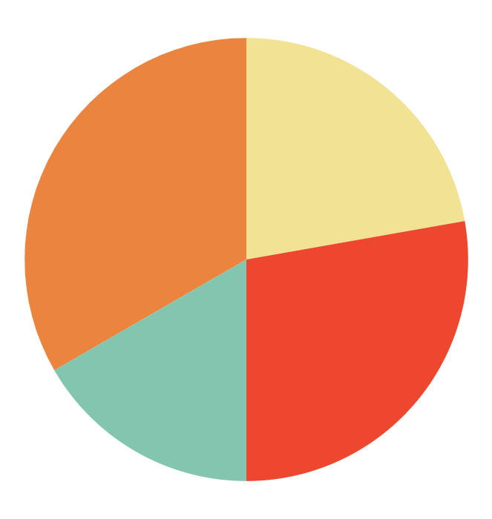
Christmas Presents Infographics
TECHNOLOGY
Music equipment
Neptune is the fourth-largest planet
Saturn is composed of hydrogen and helium
25%
30%
books
toys
20%
Jupiter is the biggest planet of them all
Venus is the second planet from the Sun
15%
Follow the link in the graph to modify its data and then paste the new one here. For more info, click here

Slide 19
Christmas Presents Infographics
Find the perfect present
Write the present you want from Santa
Write the present you want from Santa
Write the present you want from Santa
Write the present you want from Santa
profile
Interests
35 years old
Man

Slide 20
Christmas Presents Infographics
november
su | m | tu | w | th | f | Sa
 | 1 | 2 | 3 | 4 | 5 | 6
7 | 8 | 9 | 10 | 11 | 12 | 13
14 | 15 | 16 | 17 | 18 | 19 | 20
21 | 22 | 23 | 24 | 25 | 26 | 27
28 | 29 | 30
December
su | m | tu | w | th | f | Sa
 |  |  | 1 | 2 | 3 | 4
5 | 6 | 7 | 8 | 9 | 10 | 11
12 | 13 | 14 | 15 | 16 | 17 | 18
19 | 20 | 21 | 22 | 23 | 24 | 25
26 | 27 | 28 | 29 | 30 | 31
January
su | m | tu | w | th | f | Sa
(30) | (31) |  |  |  |  | 1
2 | 3 | 4 | 5 | 6 | 7 | 8
9 | 10 | 11 | 12 | 13 | 14 | 15
16 | 17 | 18 | 19 | 20 | 21 | 22
23 | 24 | 25 | 26 | 27 | 28 | 29
Festivities
Sales

Slide 21
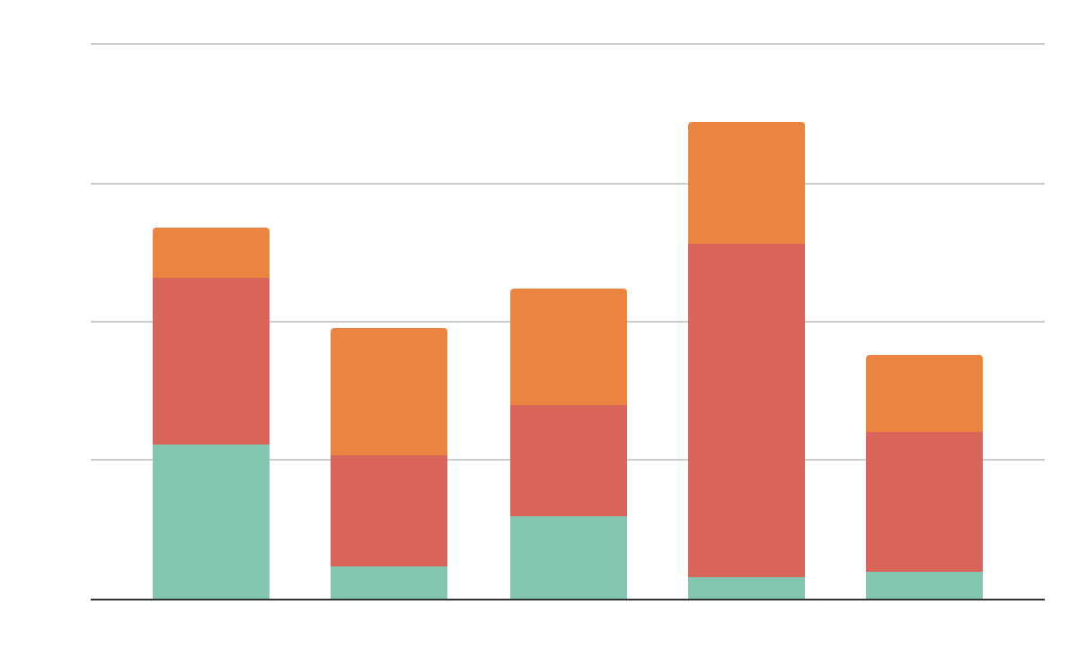
Christmas Presents Infographics
toys
Mercury is the smallest planet
technology
Saturn is a gas giant and has rings
supplies
Follow the link in the graph to modify its data and then paste the new one here. For more info, click here
Jupiter is the biggest planet of them all

Slide 22
Christmas Presents Infographics
50%
75%
25%
technoloGY
books
toys
Jupiter is the biggest planet of them all
Saturn is composed of hydrogen and helium
Mercury is the smallest planet of them all

Slide 23
Christmas Presents Infographics
Prep time:
10-20 mins
ingredients:
5g Mercury
10g Neptune
8g Mars
25g Saturn
1 spoon Venus
serves:
8-10 slices
preparation
notes:
Mercury is the closest planet to the Sun
Venus is the second planet from the Sun
Mars is actually a very cold place
Neptune is the farthest planet from the Sun

Slide 24
Christmas Presents Infographics
Santa’s Team
Worker | Job
Mr. Snowman | Mercury is a small planet
Johnny the Elf | Venus has a beautiful name
Grinch | Mars is a very cold place
Teddy the Bear | Jupiter is the biggest planet
Rudolph the Reindeer | Neptune is far away

Slide 25
Christmas Presents Infographics
cubes
Clown
truck
Doll
Mercury is a small planet
Jupiter is the biggest planet
Saturn is the ringed planet
Neptune is far away from us

Slide 26
Christmas Presents Infographics
venus
mercury
Venus is the second planet from the Sun
Mercury is the closest planet to the Sun
jupiter
mars
Jupiter is the biggest planet of them all
Mars is actually a very cold place

Slide 27
Christmas Presents Infographics
House decorations
traditional
modern
outdoor
Jupiter is the biggest planet of them all
Venus is the second planet from the Sun
Saturn is composed of hydrogen and helium

Slide 28
Christmas Presents Infographics
Jupiter is the biggest planet in the Solar System
01.
02.
Saturn is the ringed planet and a gas giant
Despite being red, Mars is actually a cold place
03.
from: laura SMITH
04.
Venus is the second planet from the Sun
to: ROCIO MCKANE

Slide 29
Christmas Presents Infographics
Mercury
100%
Mercury is the closest planet to the Sun
Venus
60%
Venus is the second planet from the Sun
Saturn
80%
Saturn is a gas giant and has rings

Slide 30
Christmas Presents Infographics
venus
60%
Venus is the second planet from the Sun
20%
mercury
Mercury is the closest planet to the Sun
20%
jupiter
Jupiter is the biggest planet of them all

Slide 31
Infographics
You can add and edit some infographics to your presentation to show your data in a visual way.
Choose your favourite infographic and insert it in your presentation using Ctrl C + Ctrl V or Cmd C + Cmd V in Mac.
Select one of the parts and ungroup it by right-clicking and choosing “Ungroup”.
Change the color by clicking on the paint bucket.
Then resize the element by clicking and dragging one of the square-shaped points of its bounding box (the cursor should look like a double-headed arrow). Remember to hold Shift while dragging to keep the proportions.
Group the elements again by selecting them, right-clicking and choosing “Group”.
Repeat the steps above with the other parts and when you’re done editing, copy the end result and paste it into your presentation.
Remember to choose the “Keep source formatting” option so that it keeps the design. For more info, please visit GreatPPT.com.

Slide 32
www.greatppt.com
Free Templates and Themes
Create beautiful presentations in minutes

