Slide 1
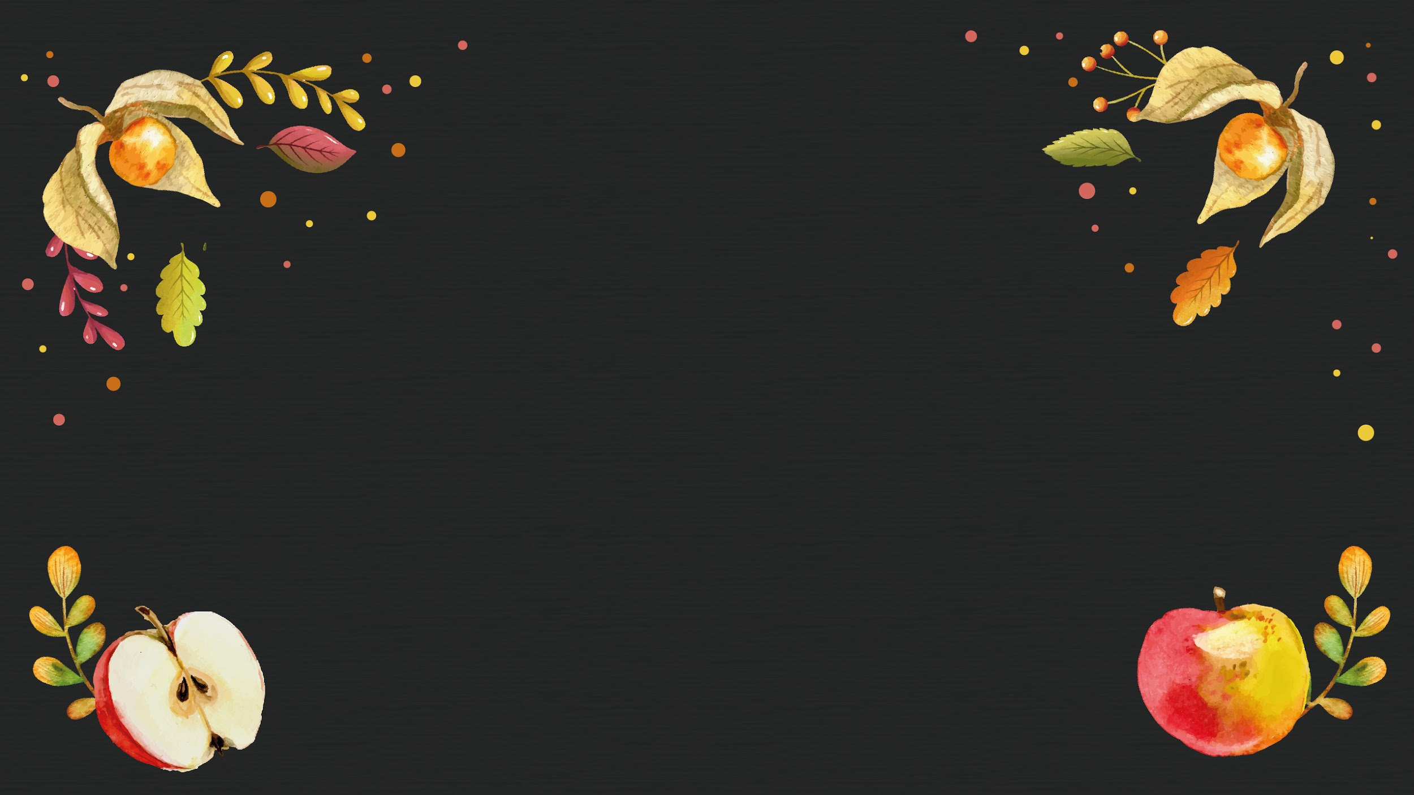
Lovely Thanksgiving
Here is where your presentation begins

Slide 2
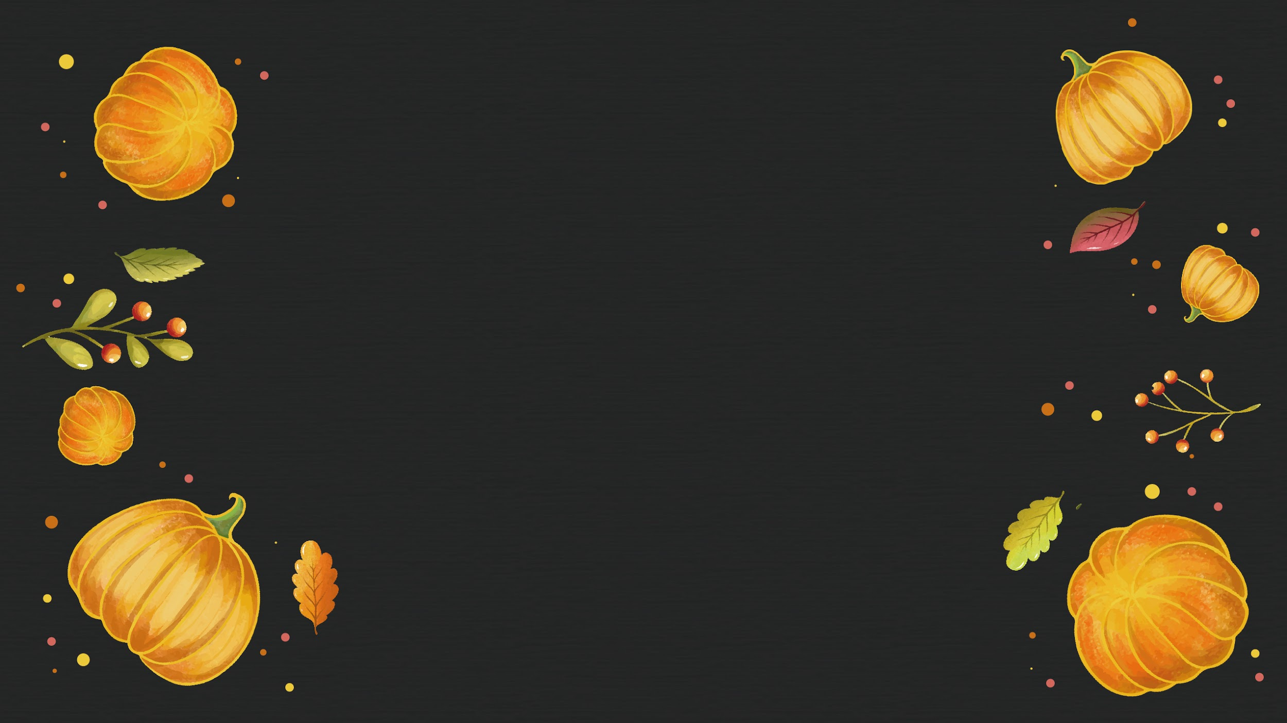
Whoa!
This could be the part of the presentation where you can introduce yourself

Slide 3

“This is a quote, words full of wisdom that someone important said and can make the reader get inspired.”
—Someone Famous

Slide 4
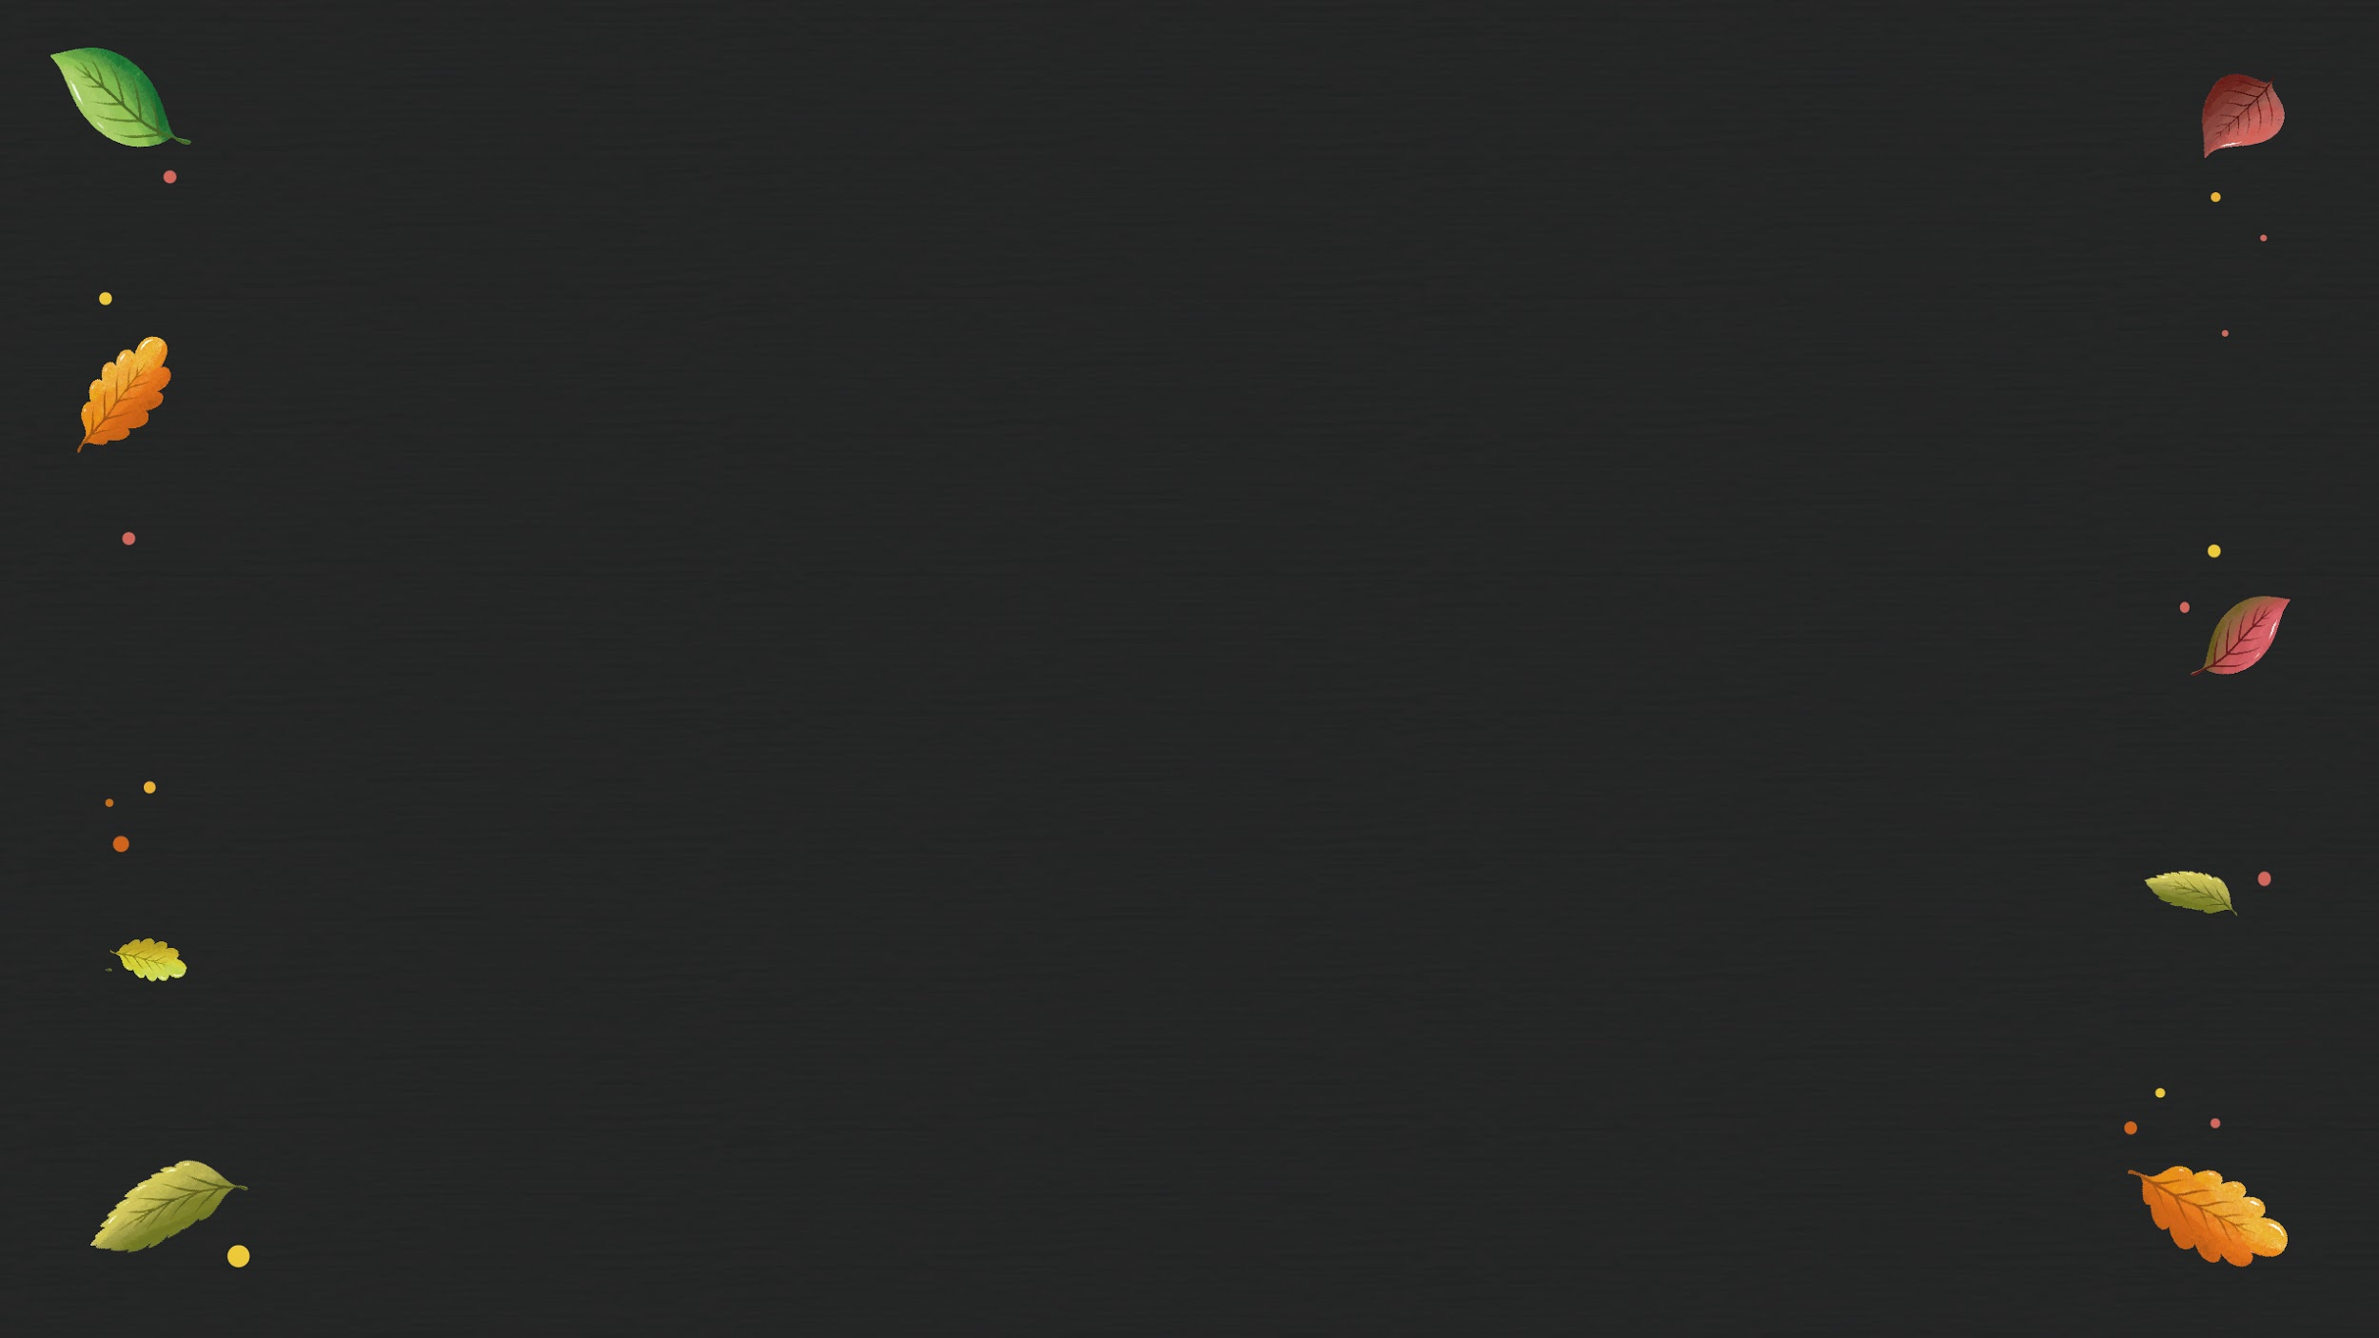
Table of contents
01
02
03
04
Venus
Mars
It’s the second planet from the Sun
Despite being red, Mars is a cold place
Saturn
Neptune
Saturn is the ringed one and a gas giant
It’s the farthest planet from the Sun

Slide 5
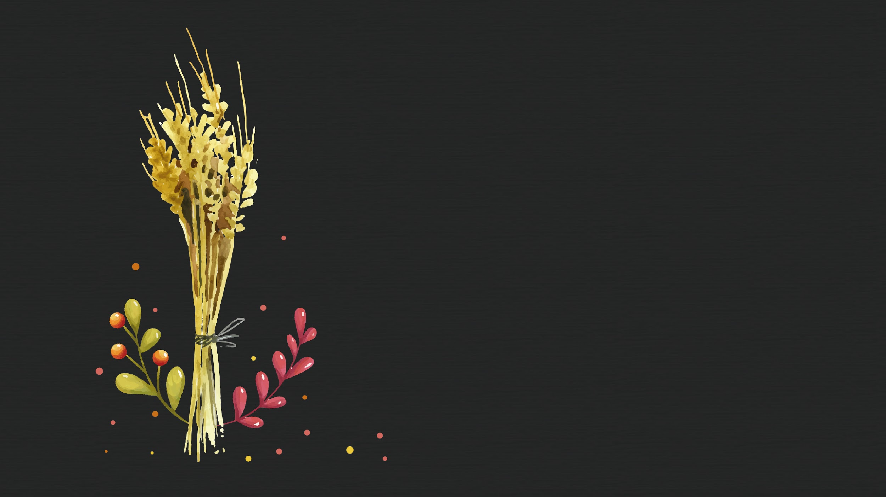
01
Company
You can enter a subtitle here if you need it

Slide 6

The slide title goes here!
Do you know what helps you make your point clear? Lists like this one:
They’re simple
You can organize your ideas clearly
You’ll never forget to buy milk!
And the most important thing: the audience won’t miss the point of your presentation

Slide 7

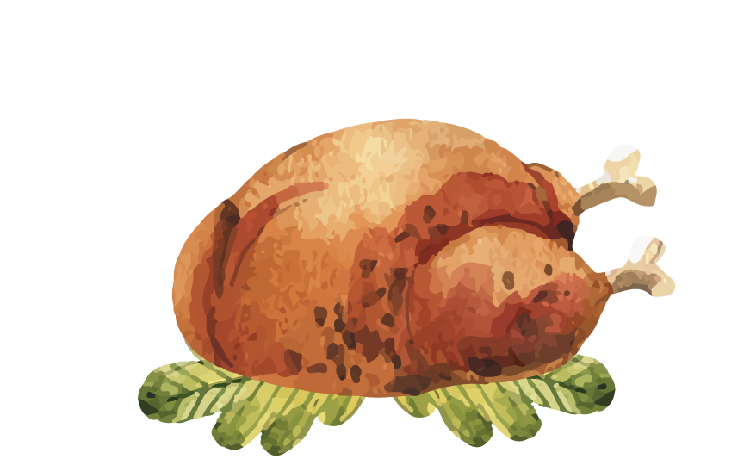
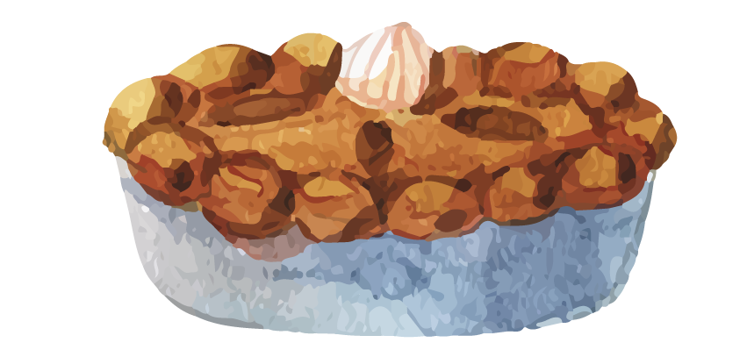
Maybe you need to divide the content
Mercury
Venus
The closest planet to the Sun and the smallest one in the Solar System
Venus has a beautiful name and is the second planet from the Sun

Slide 8
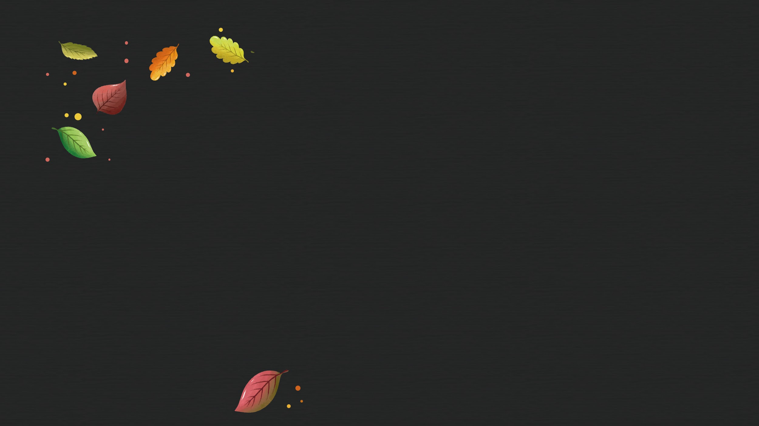
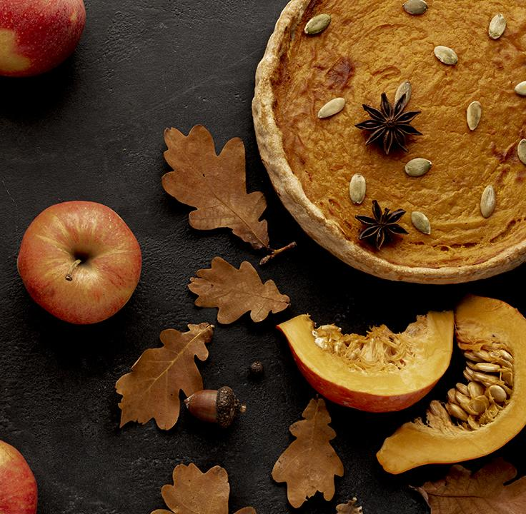
A picture always reinforces the concept
Use an image instead of long texts

Slide 9
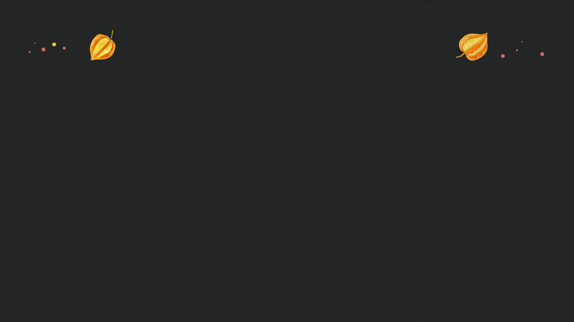
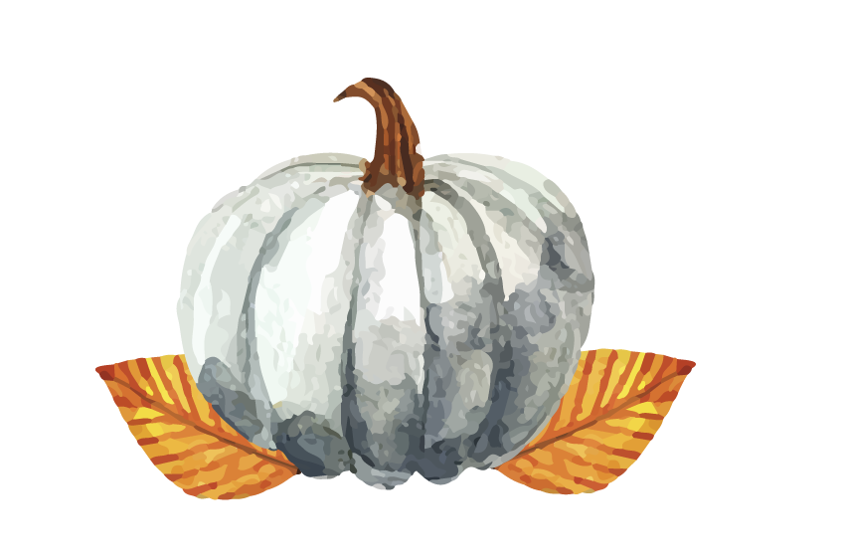
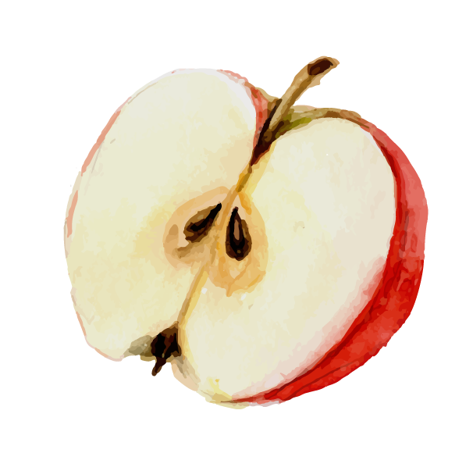
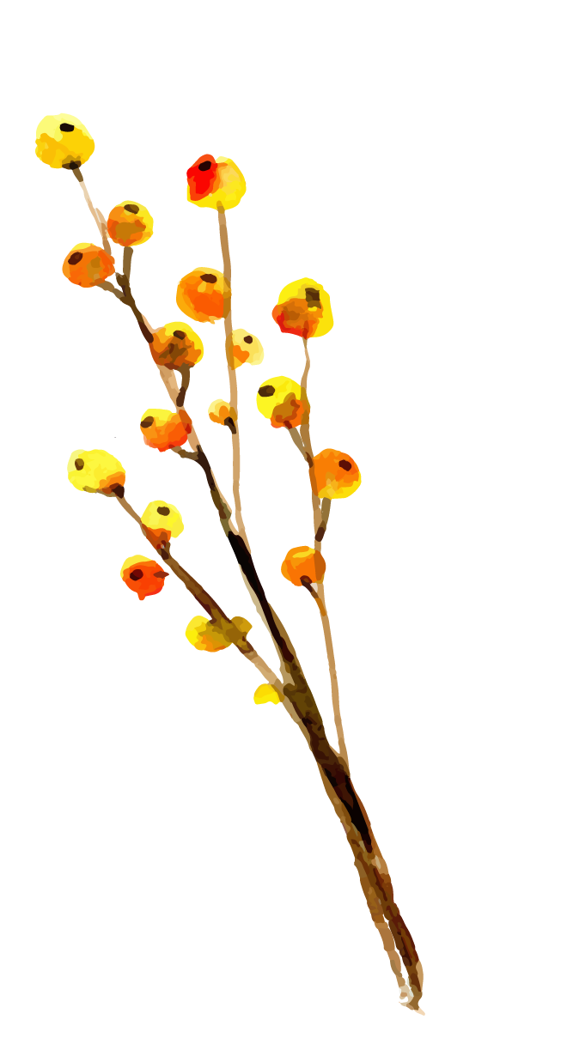
Three columns, why not?
Mars
Jupiter
Saturn
Despite being red, Mars is actually a very cold place
It’s a gas giant and the biggest planet in the Solar System
It’s a gas giant, composed mostly of hydrogen and helium

Slide 10
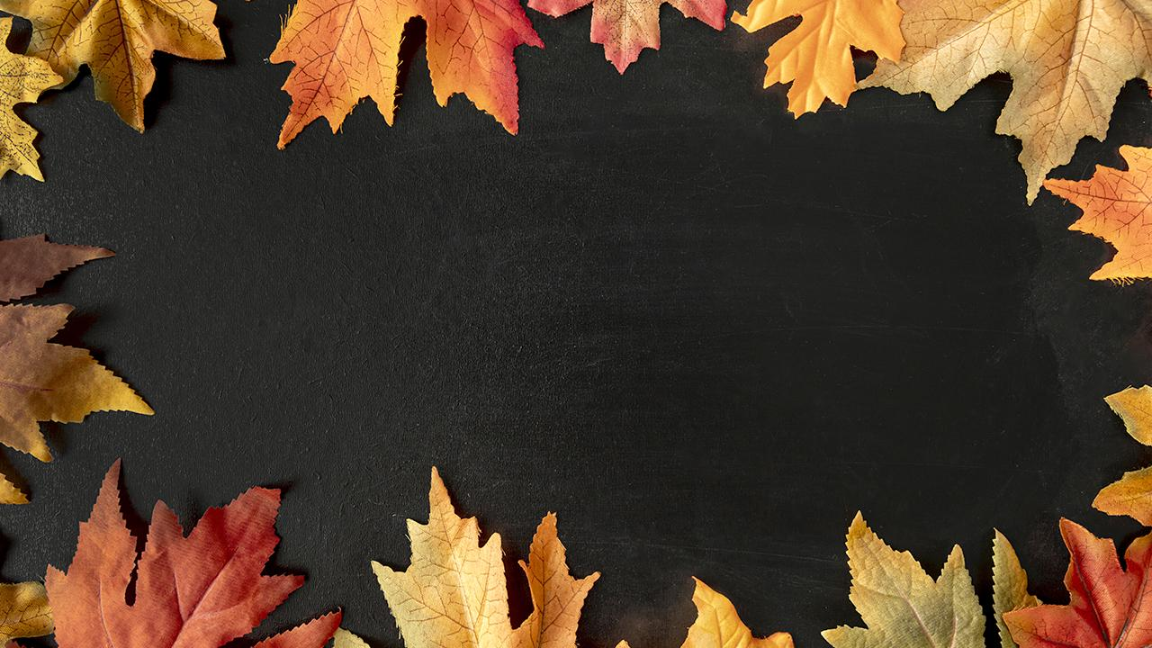
A picture is worth a thousand words

Slide 11

Awesome words
Because key words are great for catching your audience’s attention

Slide 12
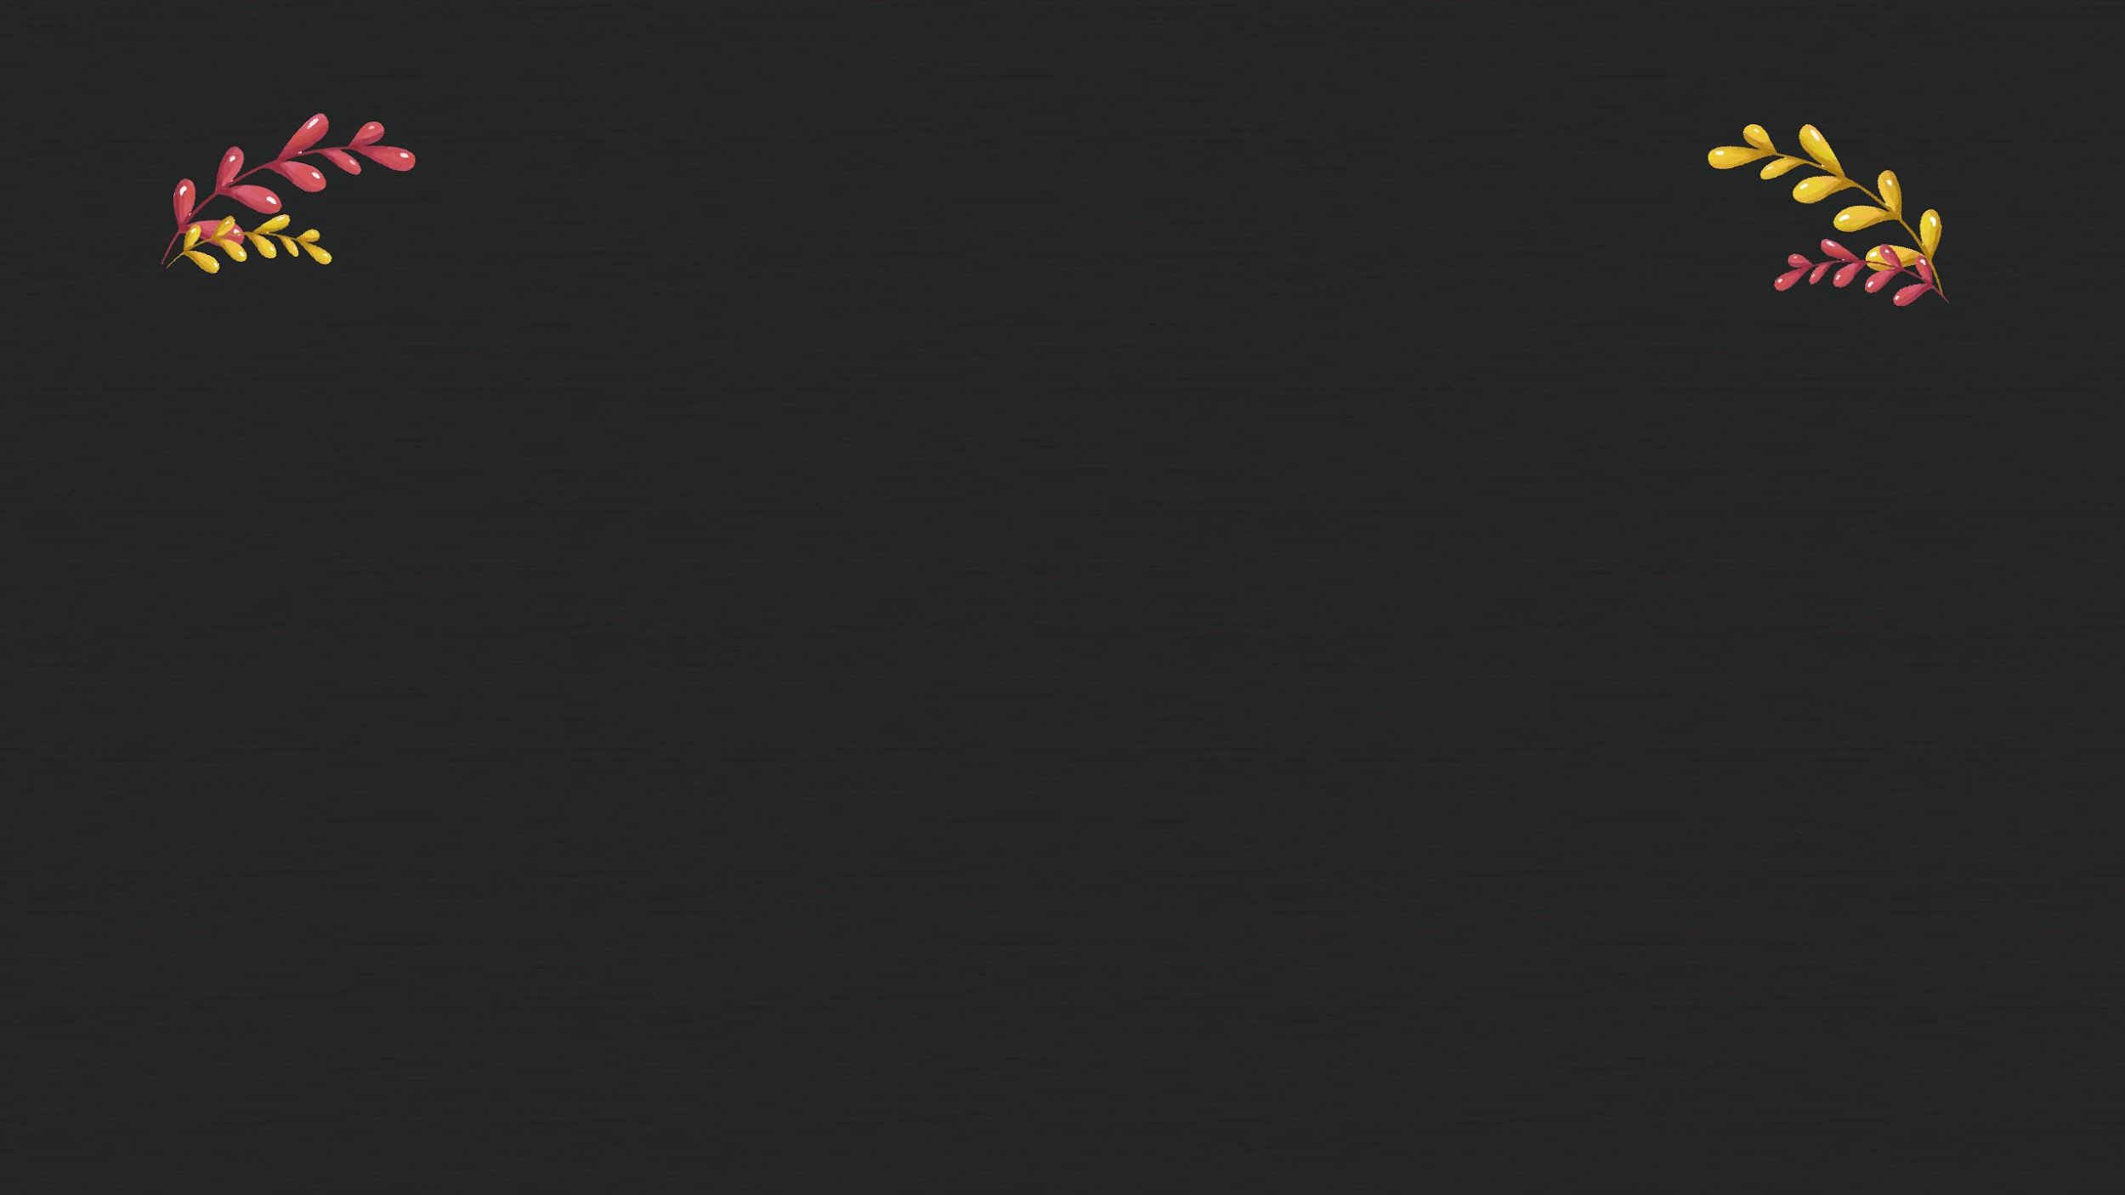
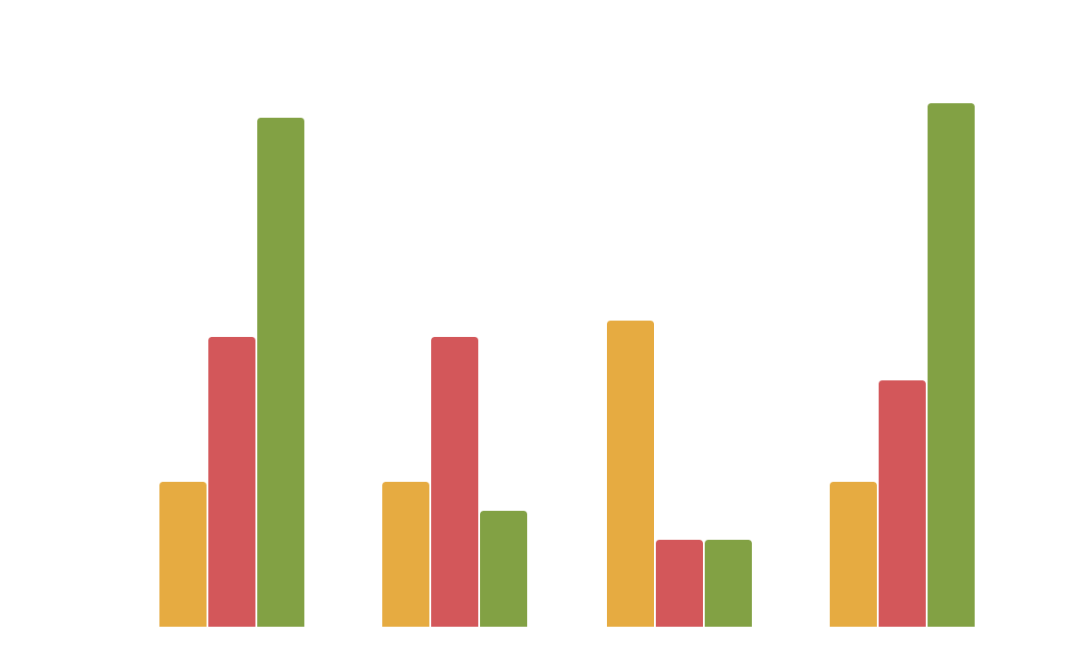
You could also use a graph
Mercury
Mercury is the closest object to the Sun
Mars
Despite being red,
Mars is a cold place
Saturn
Saturn is composed of hydrogen and helium
To modify this graph, click on it, follow the link, change the data and paste the new graph here, replacing this one

Slide 13

Reviewing concepts is a good idea
Mercury
Venus
Mars
Mercury is the closest planet to the Sun
Venus has a
beautiful name
Despite being red, Mars is a cold place
Jupiter
Saturn
Neptune
It’s the biggest planet in the Solar System
Saturn is the ringed one and a gas giant
It’s the farthest planet from the Sun

Slide 14
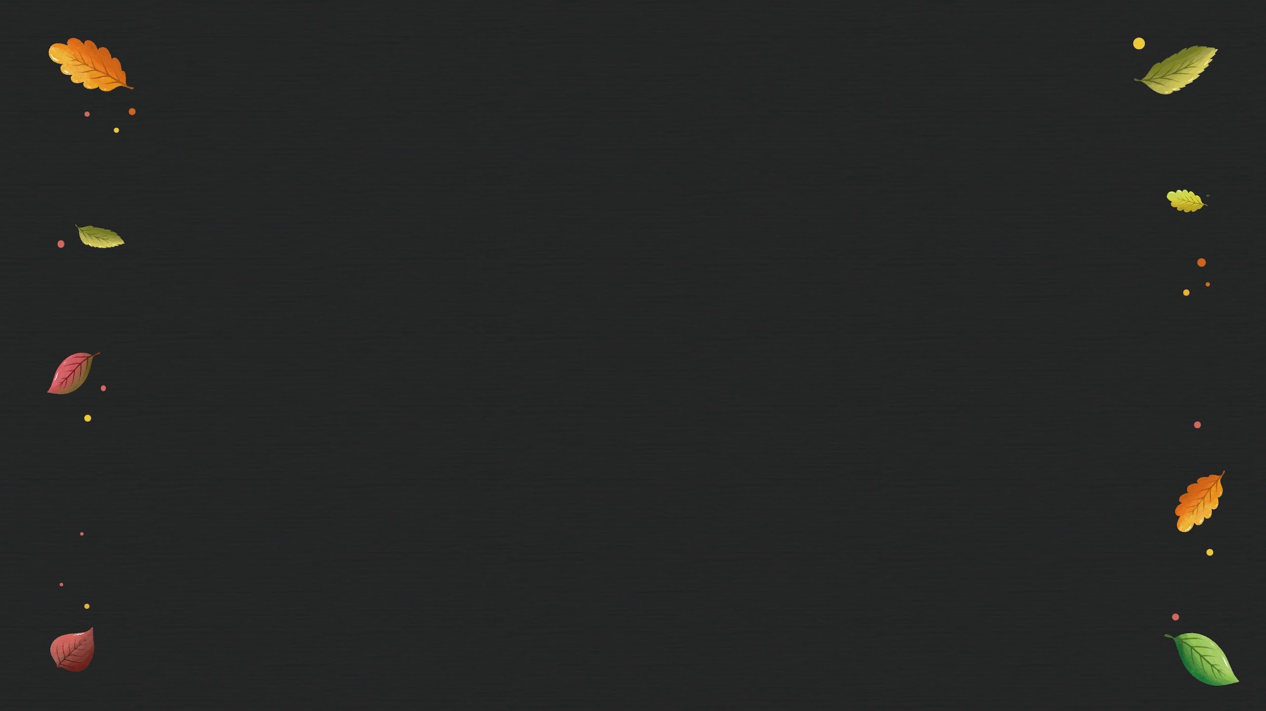
Infographics make your idea understandable...
50%
70%
Mercury is the closest planet to the Sun
Saturn is composed of hydrogen and helium
70%
60%
Is the biggest planet in the Solar System
Despite being red, Mars is a very cold place

Slide 15
...and the same goes for tables
 | Mass (earths) | Diameter (earths) | Gravity (earths)
Mercury | 0.06 | 0.38 | 0.38
Mars | 0.11 | 0.53 | 0.38
Saturn | 95.2 | 9.4 | 1.16

Slide 16
This is a map
Mercury
Mercury is the closest object to the Sun
Mars
Despite being red,
Mars is a cold place
Saturn
Saturn is composed of hydrogen and helium

Slide 17



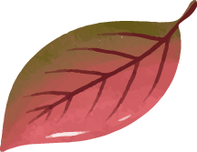
A timeline always works well
Day 1
Day 2
Day 3
Day 4
It’s the third planet from the Sun
It’s the farthest planet from the Sun
Despite being red,
Mars is a cold place
It’s the closest object to the Sun

Slide 18
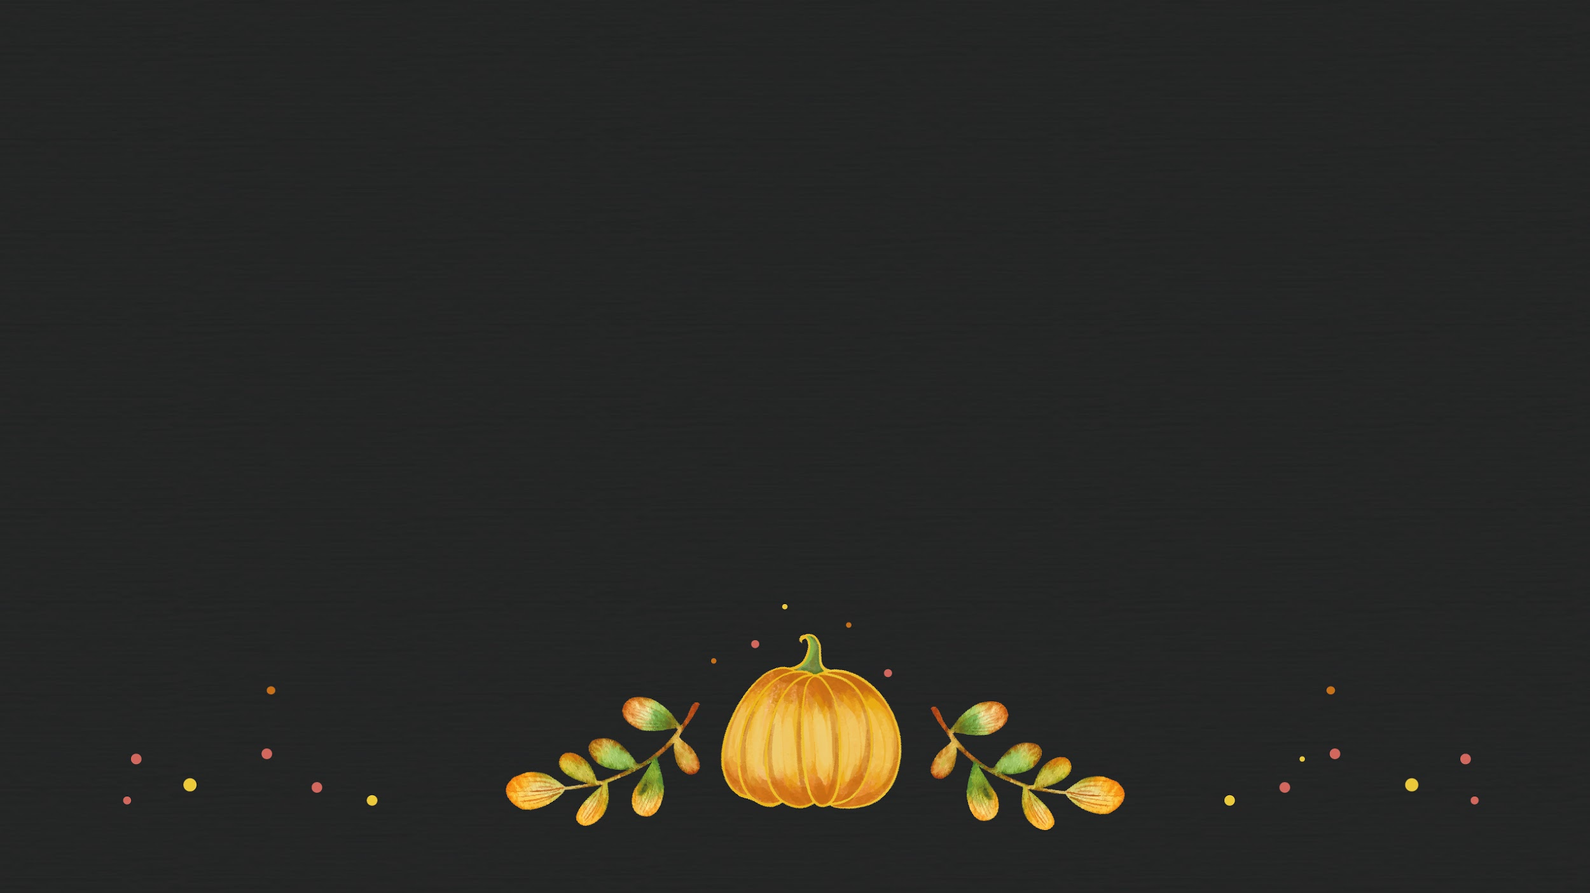
4,498,300,000
Big numbers catch your audience’s attention

Slide 19

333,000.00
24h 37m 23s
386,000 km
Earths is the Sun’s mass
Is Jupiter’s rotation period
is the distance between Earth and the Moon

Slide 20
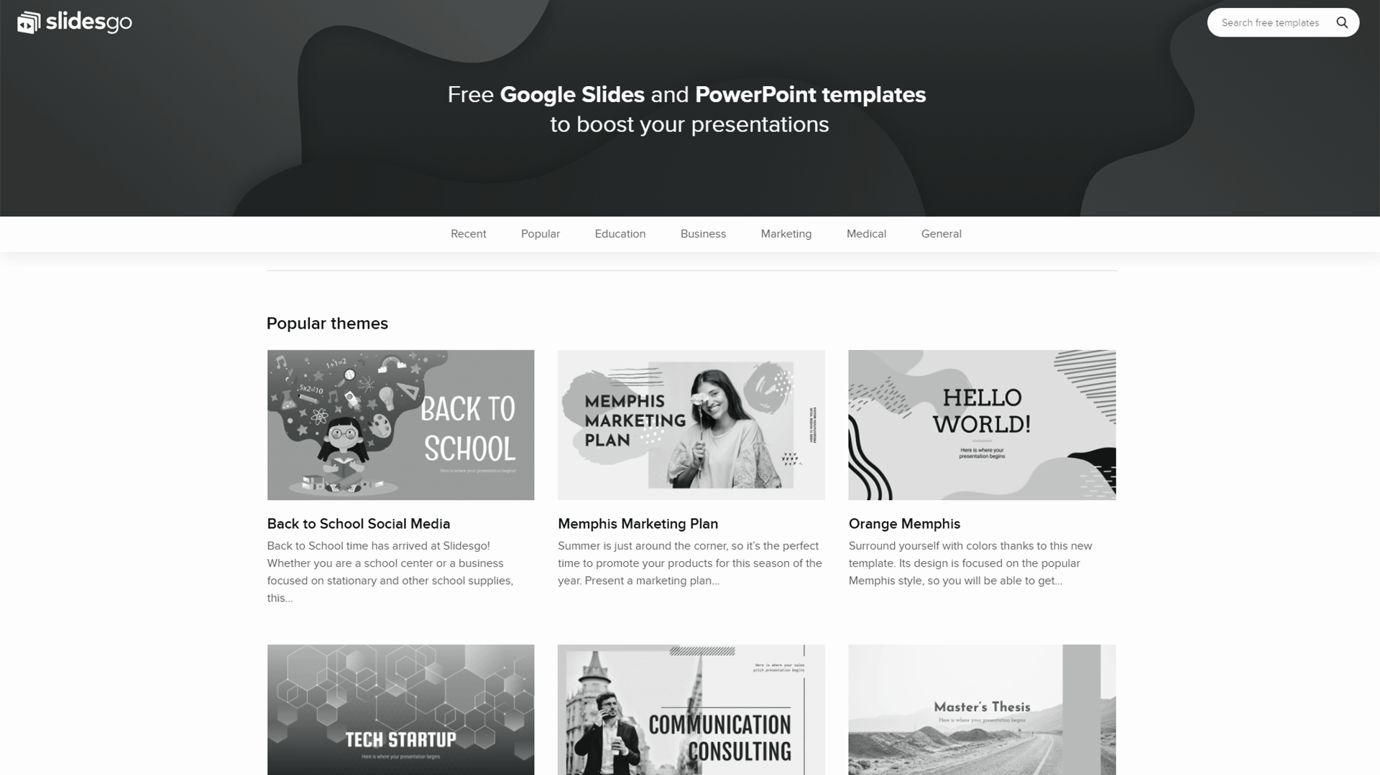

Desktop software
You can replace the image on the screen with your own work

Slide 21
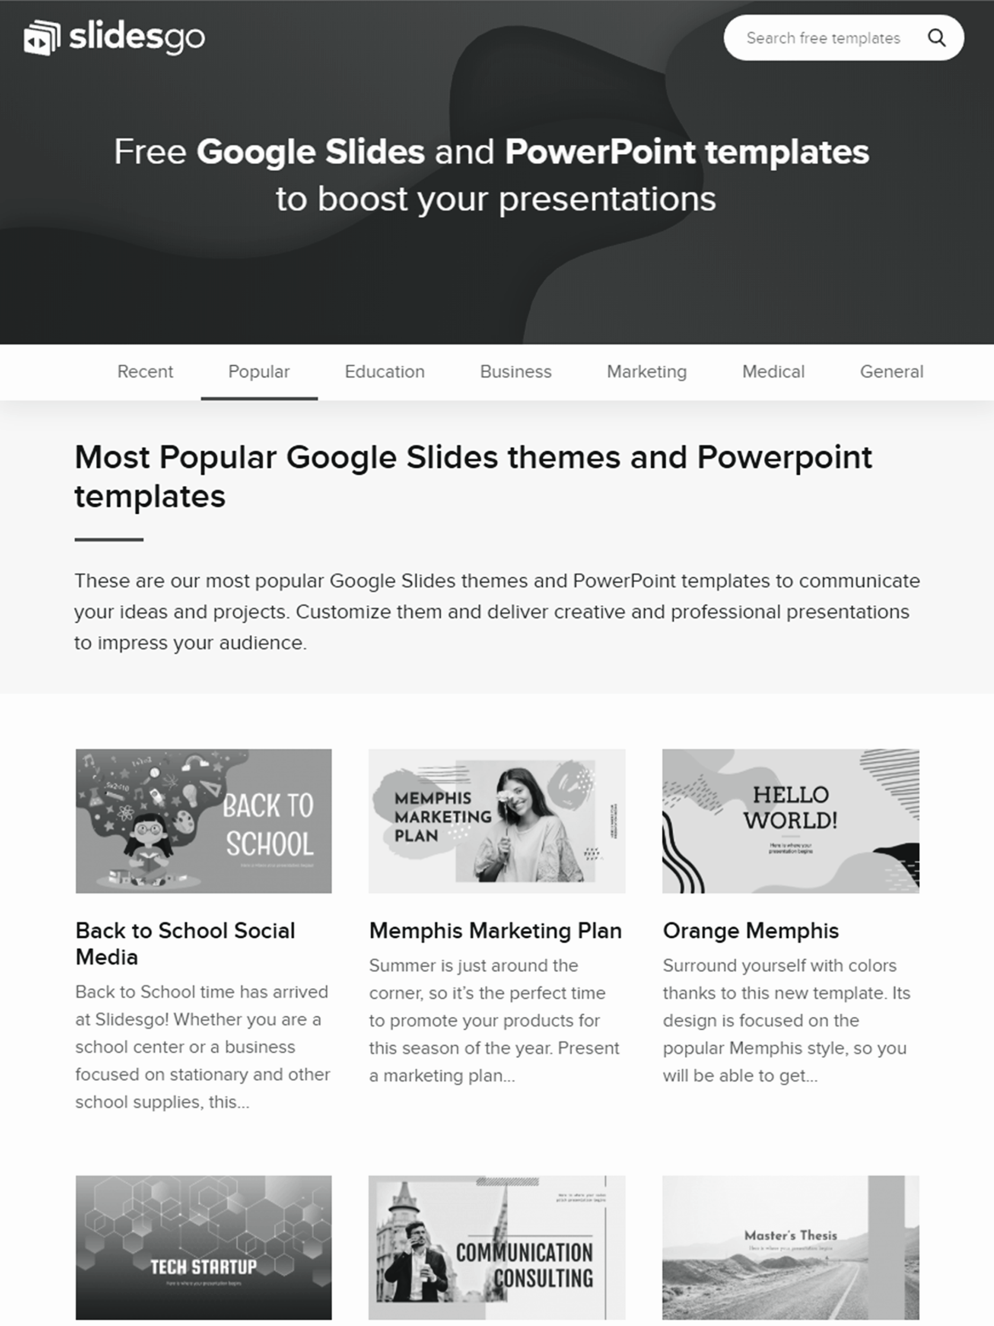

Tablet app
You can replace the image on the screen with your own work

Slide 22
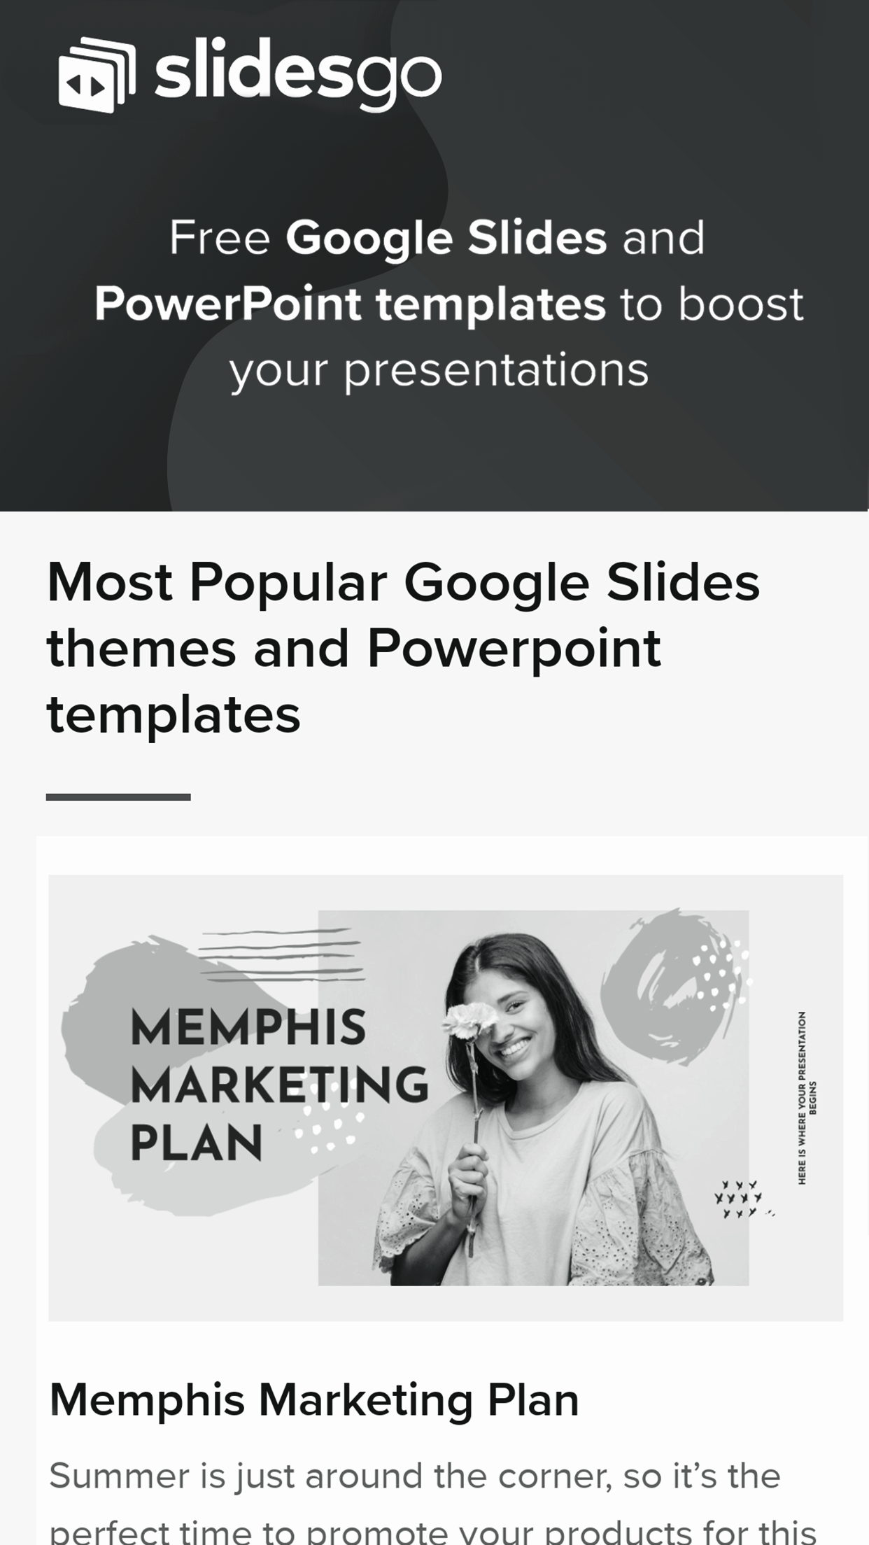

Mobile web
You can replace the image on the screen with your own work

Slide 23

What about these percentages?
50%
80%
25%
60%
Neptune
Mars
It’s the farthest planet from the Sun
Despite being red,
Mars is a cold place
Earth
Mercury
It’s the third planet from the Sun
It’s the closest object to the Sun

Slide 24

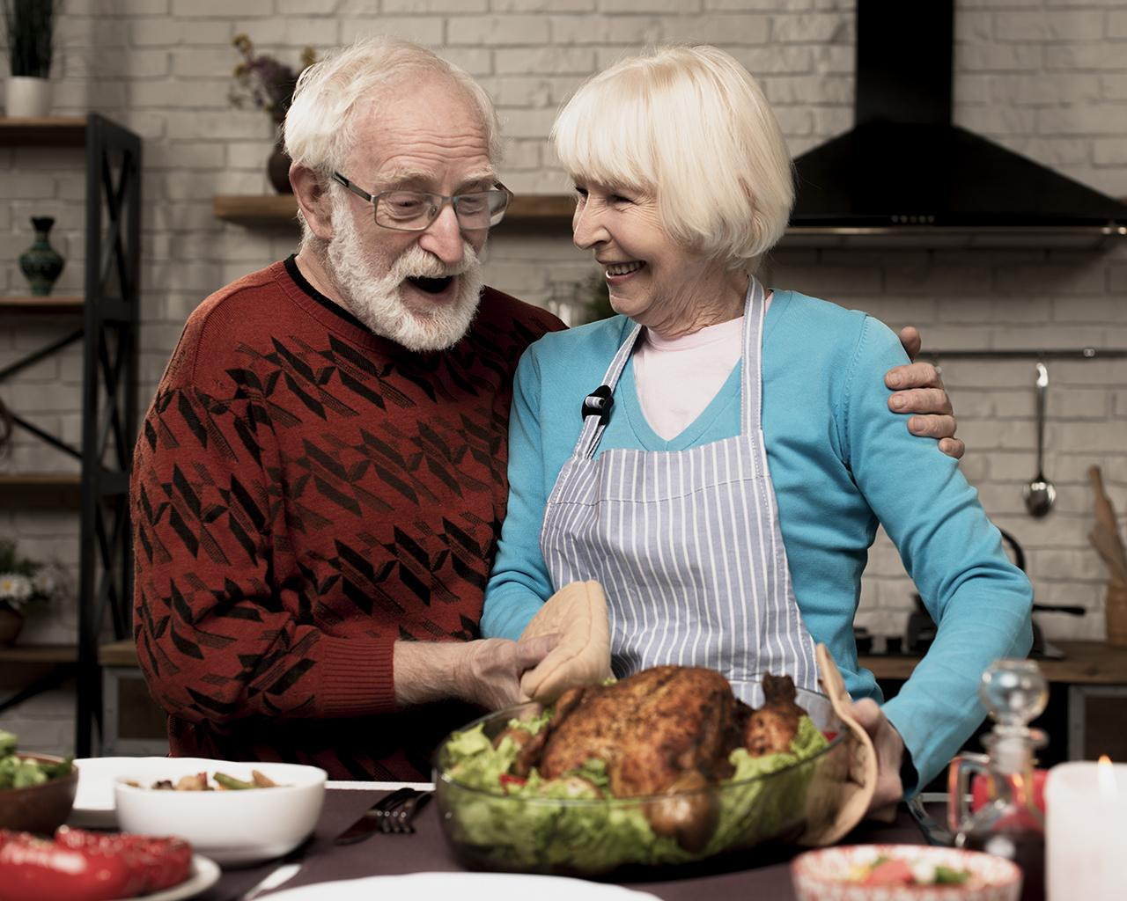
Our team
Helena James
John Doe
You can replace the image on the screen with your own
You can replace the image on the screen with your own

Slide 25
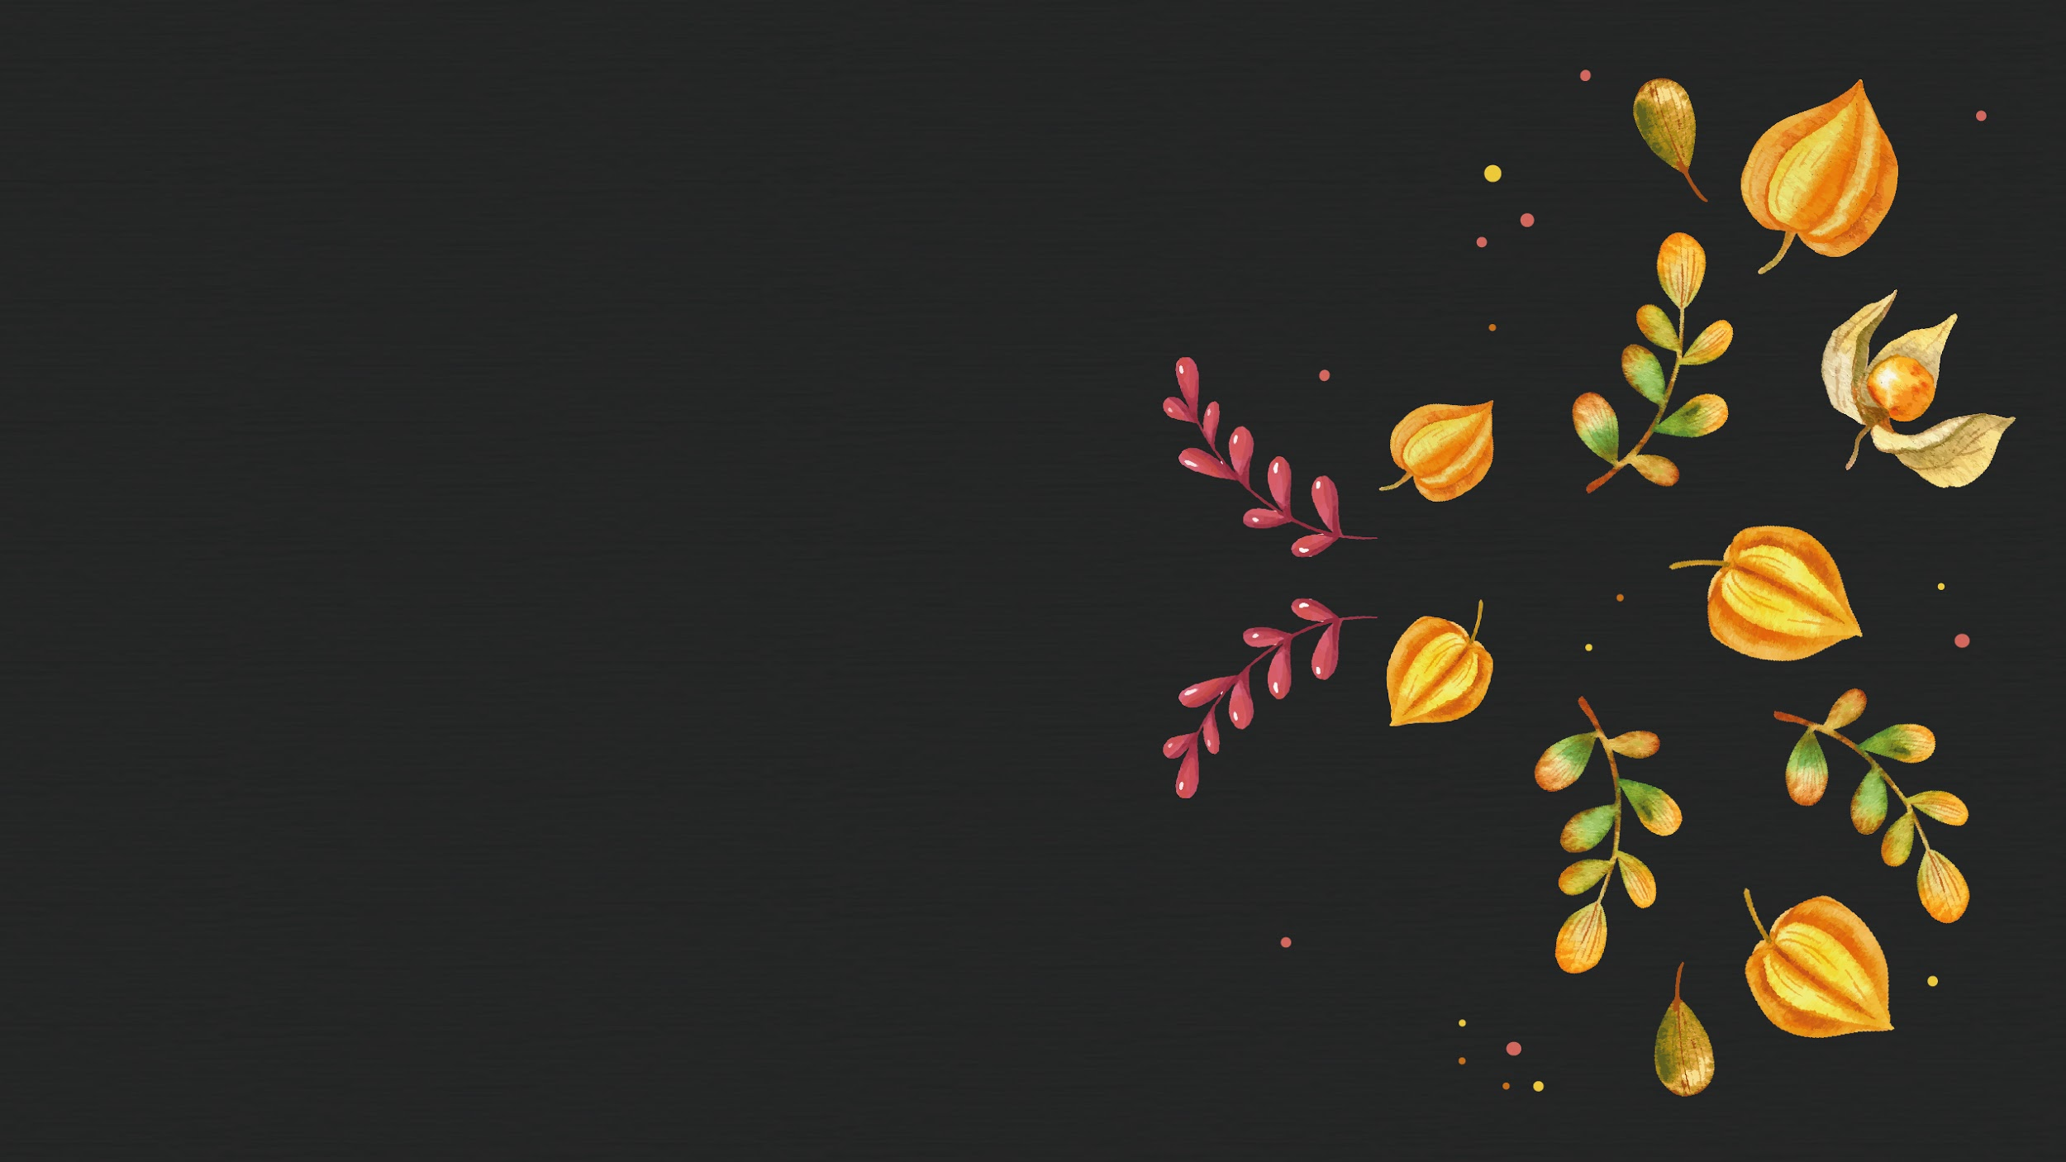
02
Dinner plan
You can enter a subtitle here if you need it

Slide 26

To do list
01
02
Mercury
Venus
Here you can enter the items for your list
Here you can enter the items for your list
Here you can enter the items for your list
Here you can enter the items for your list
Here you can enter the items for your list
Here you can enter the items for your list
Here you can enter the items for your list
Here you can enter the items for your list

Slide 27
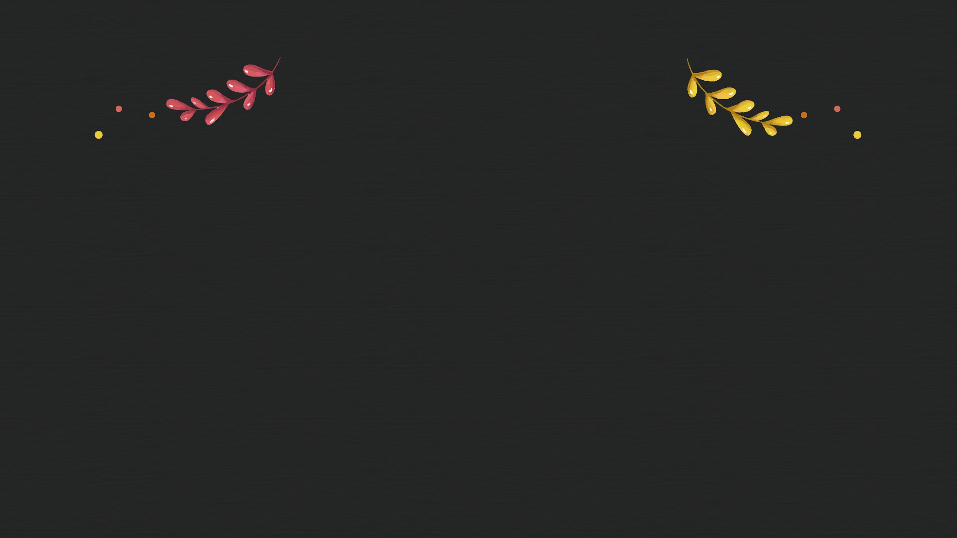
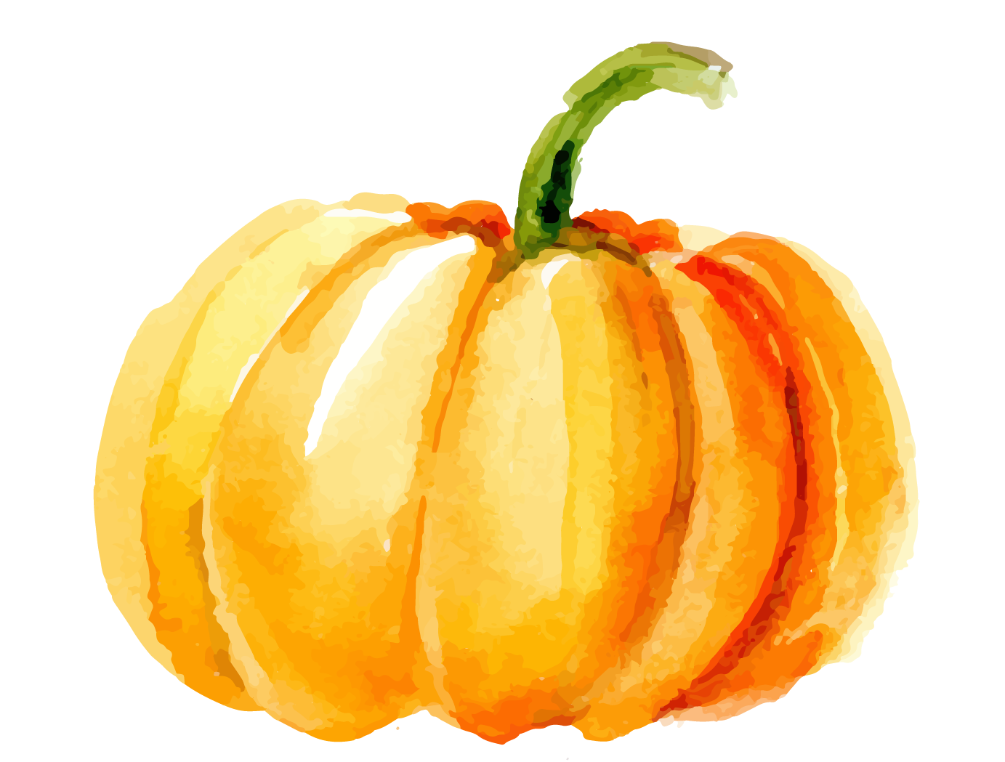
Weekly planner
Sunday | Monday | Tuesday | Wednesday | Thursday | Friday | Saturday
 |  | Buy ingredients | Pumpkin pie | Cook the turkey Decorate the table | Thanksgiving dinner

Slide 28
Menu options
Option 1
Option 2
Option 3
7 hours
10 hours
8 hours
Turkey
Stuffing/Dressing
Mashed Potatoes
Gravy
Turkey
Cranberry Sauce
Corn
Green Casserole
Turkey
Candied Yams
Pumpkin Pie
Pecan Pie

Slide 29

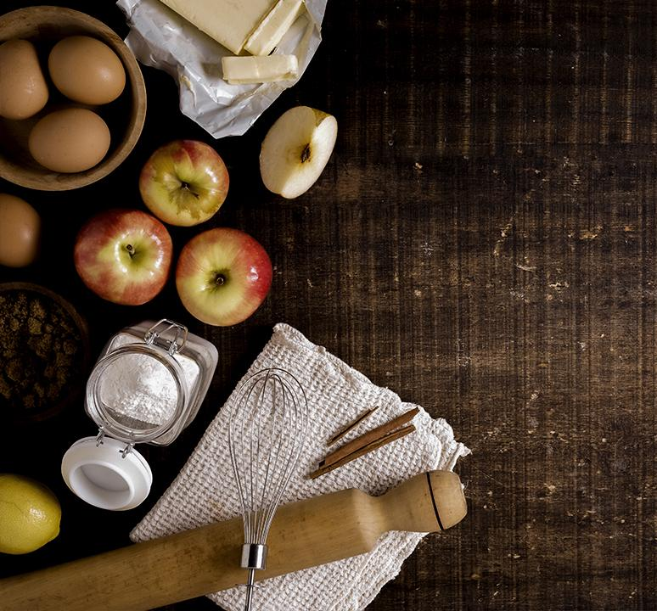
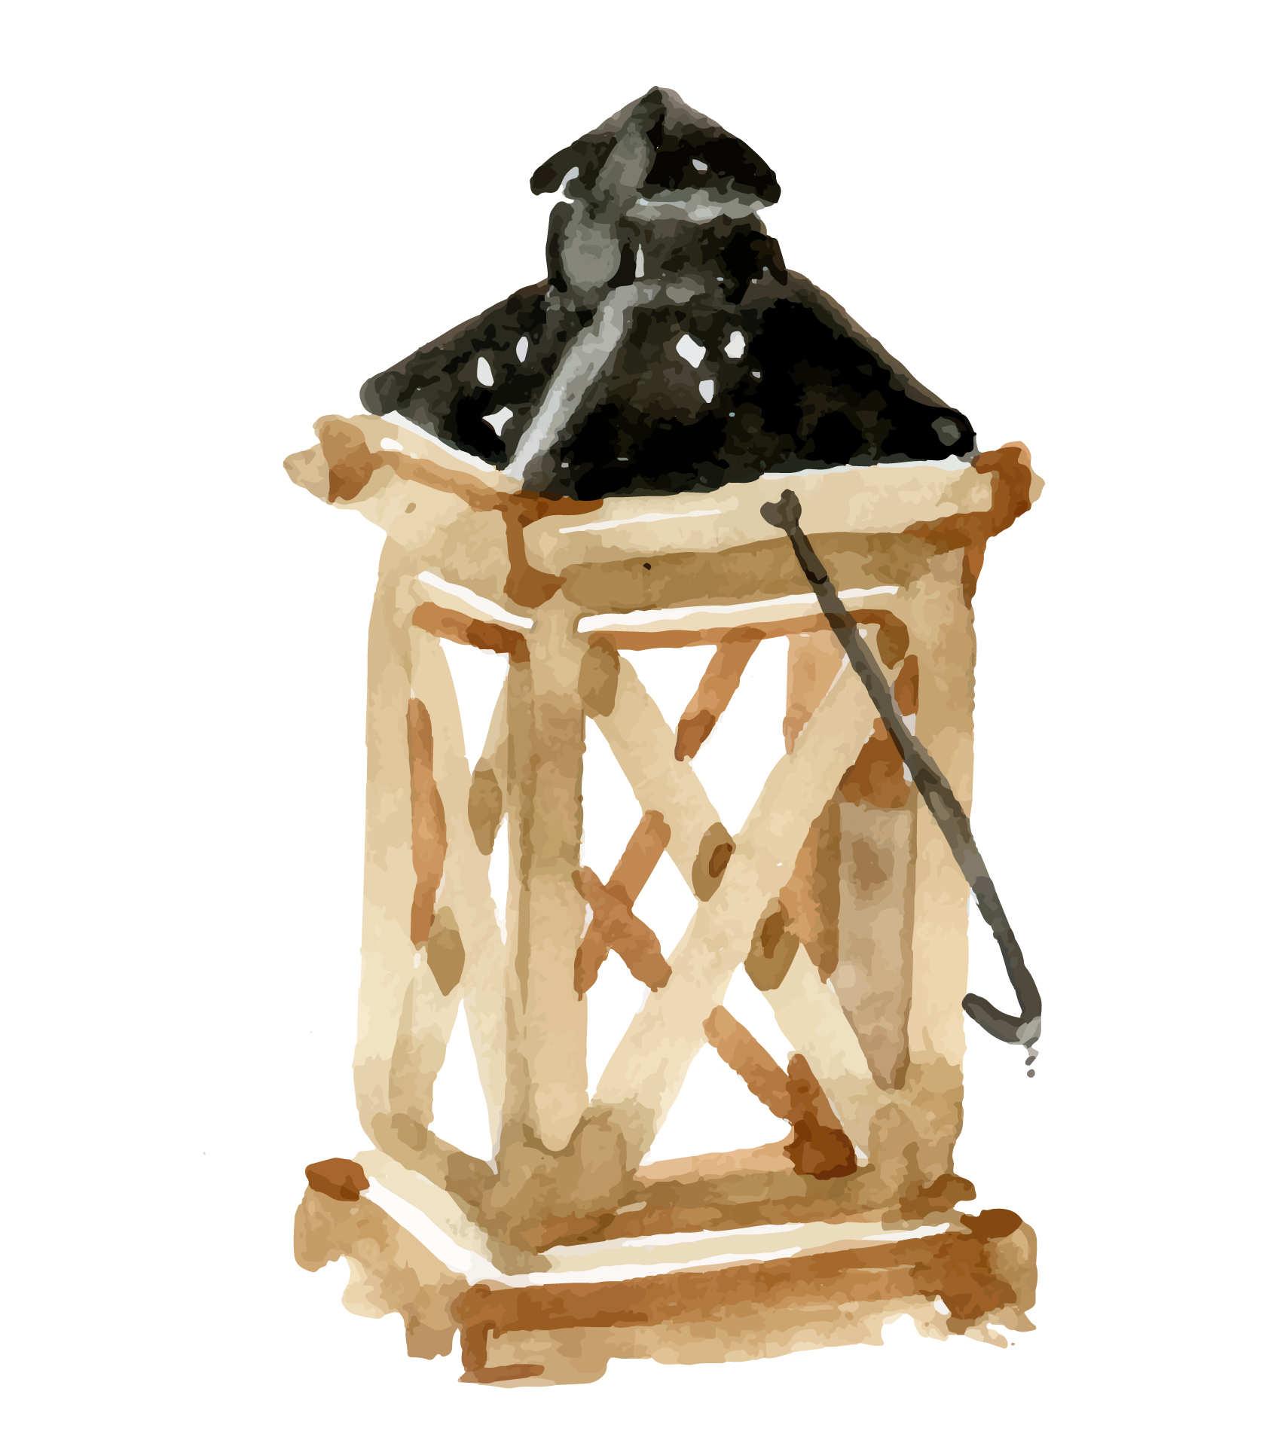
Cooking recipe
Ingredients
Mars (1kg)
Jupiter (1 piece)
Venus (250 ml)
Mercury (2 piece)
Saturn (2kg)
Earth (1 piece)
Neptune
Solar System
Sun (2 piece)
Moon (250 ml)
Planet
Mercury
Saturn

Slide 30
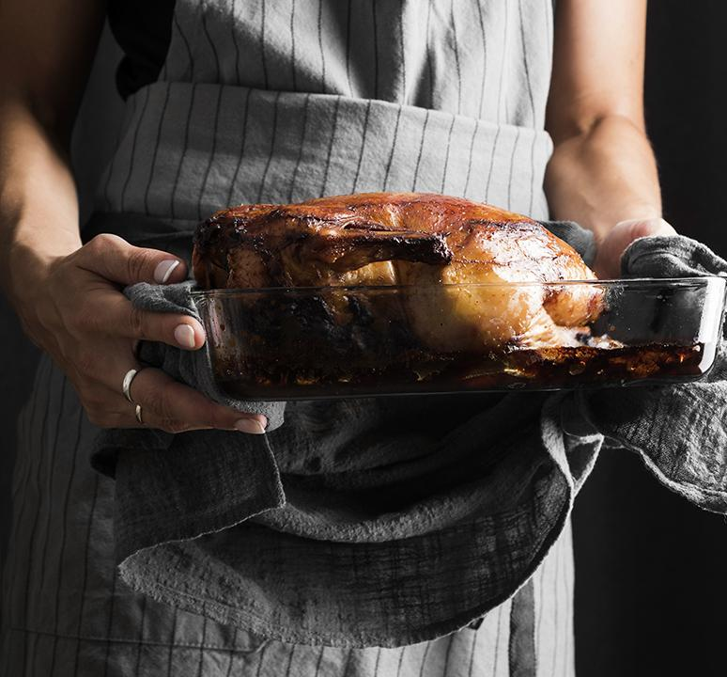
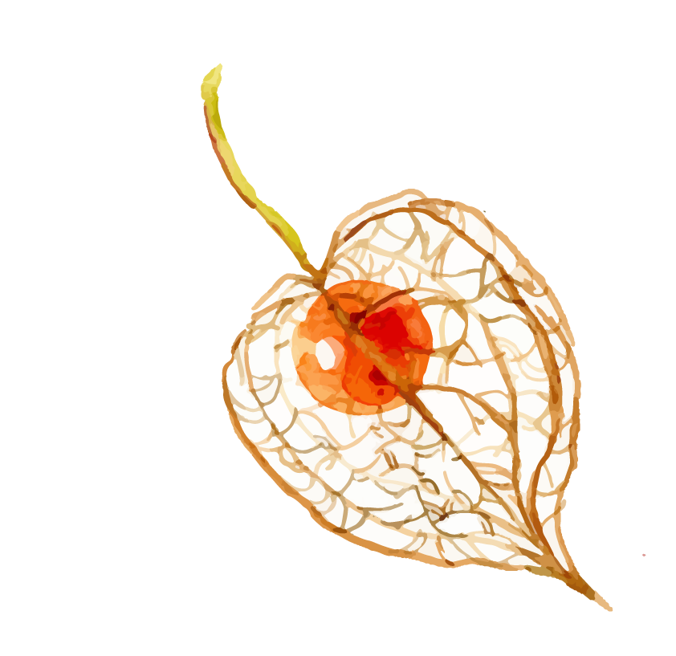
Cooking recipe
Steps
It’s the third planet from the Sun
It’s the farthest planet from the Sun
Despite being red, Mars is a cold place
Mercury is the closest object to the Sun
It’s composed of hydrogen and helium
Saturn is the ringed one and a gas giant

Slide 31
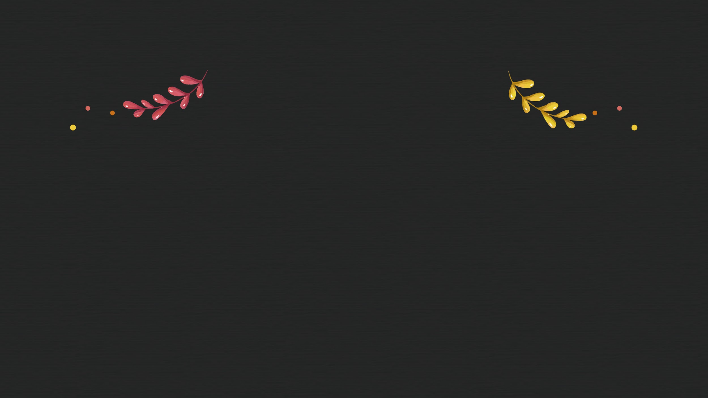
Seating plan
Jackie
Mike
John
Helena
Watson
Hugh

Slide 32

The party is divided into four parts
Step 1
Step 2
Step 3
Step 4
It’s the closest planet to the Sun
Mars is actually a cold place
Venus has a
beautiful name
Saturn is the ringed one and a gas giant

Slide 33

Thanks!
Do you have any questions?
great_ppt@outlook.com
+1(540) 328-0772
www.greatppt.com
Please keep this slide for attribution

Slide 34

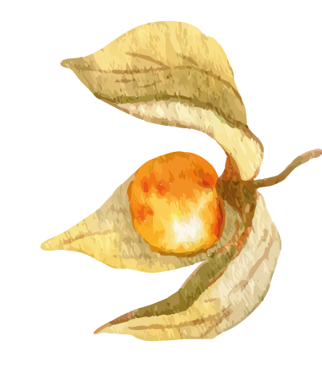
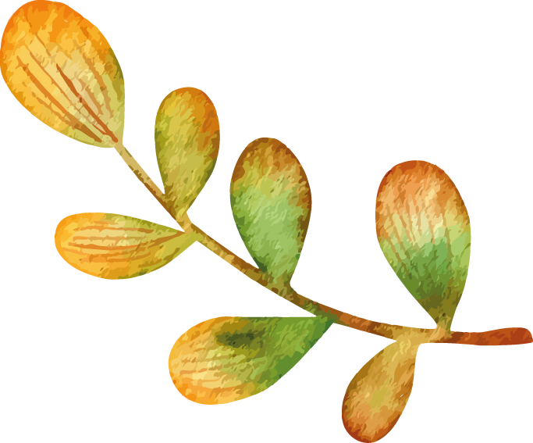
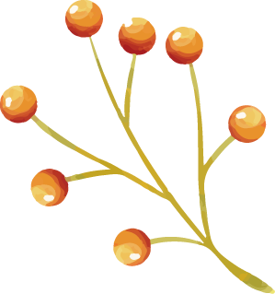
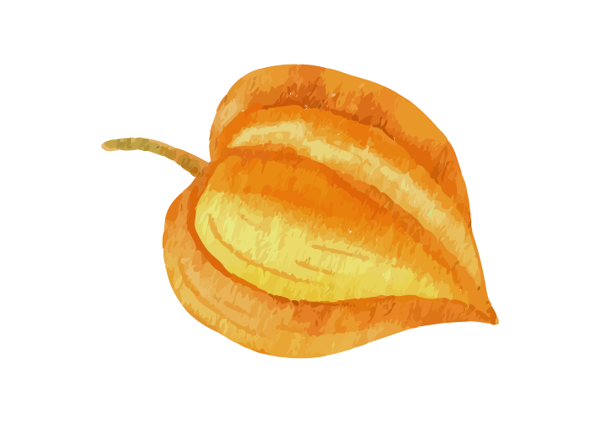
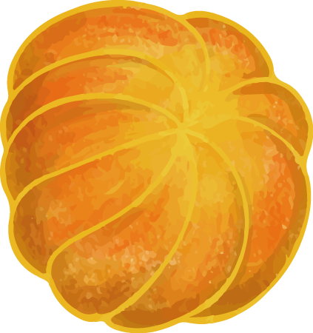
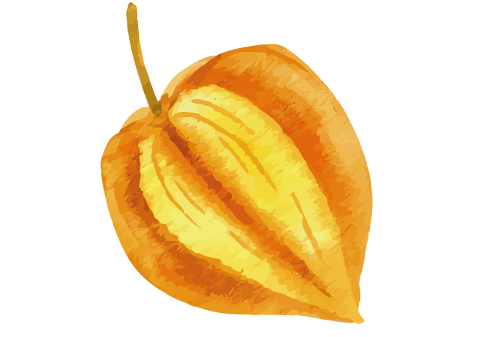
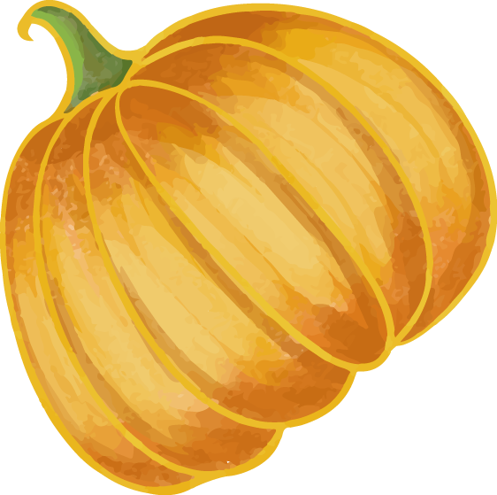

Alternative resources

Slide 35
Fonts & colors used
This presentation has been made using the following fonts:
Courgette
(https://fonts.google.com/specimen/Courgette)
Raleway
(https://fonts.google.com/specimen/Raleway)
#ecc838
#d3575a
#c76e16
#82a144
#e6ab41

Slide 36

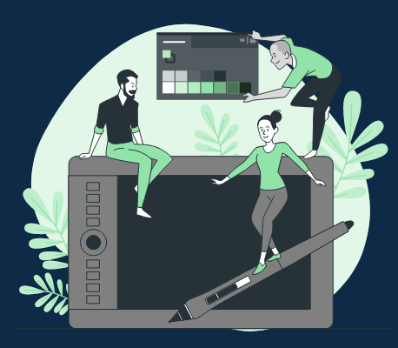



Stories by Freepik
Create your Story with our illustrated concepts. Choose the style you like the most, edit its colors, pick the background and layers you want to show and bring them to life with the animator panel! It will boost your presentation. Check out How it Works.
Pana
Amico
Bro
Rafiki
Cuate

Slide 37
Use our editable graphic resources...
You can easily resize these resources without losing quality. To change the color, just ungroup the resource and click on the object you want to change. Then, click on the paint bucket and select the color you want. Group the resource again when you’re done. You can also look for more infographics on Slidesgo.

Slide 40
JANUARY
FEBRUARY
MARCH
APRIL
MAY
JUNE
PHASE 1
Task 1
Task 2
PHASE 2
Task 1
Task 2
JANUARY
FEBRUARY
MARCH
APRIL
PHASE 1
Task 1
Task 2

Slide 43
...and our sets of editable icons
You can resize these icons without losing quality.
You can change the stroke and fill color; just select the icon and click on the paint bucket/pen.
In Google Slides, you can also use Flaticon’s extension, allowing you to customize and add even more icons.

Slide 44
Educational Icons
Medical Icons

Slide 45
Business Icons
Teamwork Icons

Slide 46
Help & Support Icons
Avatar Icons

Slide 47
Creative Process Icons
Performing Arts Icons

Slide 48
Nature Icons

Slide 49
SEO & Marketing Icons

Slide 50
www.greatppt.com
Free Templates and Themes
Create beautiful presentations in minutes

